Slide 1
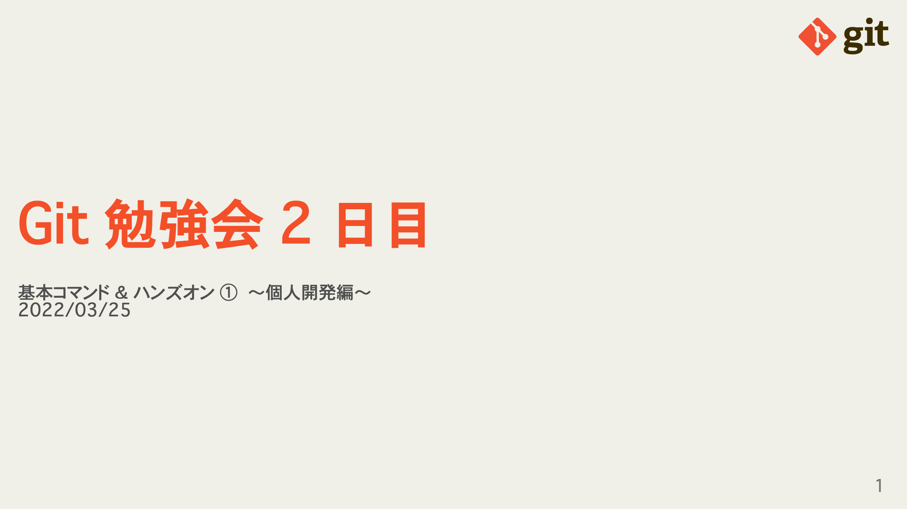
Notes:
omit in toc

Slide 2
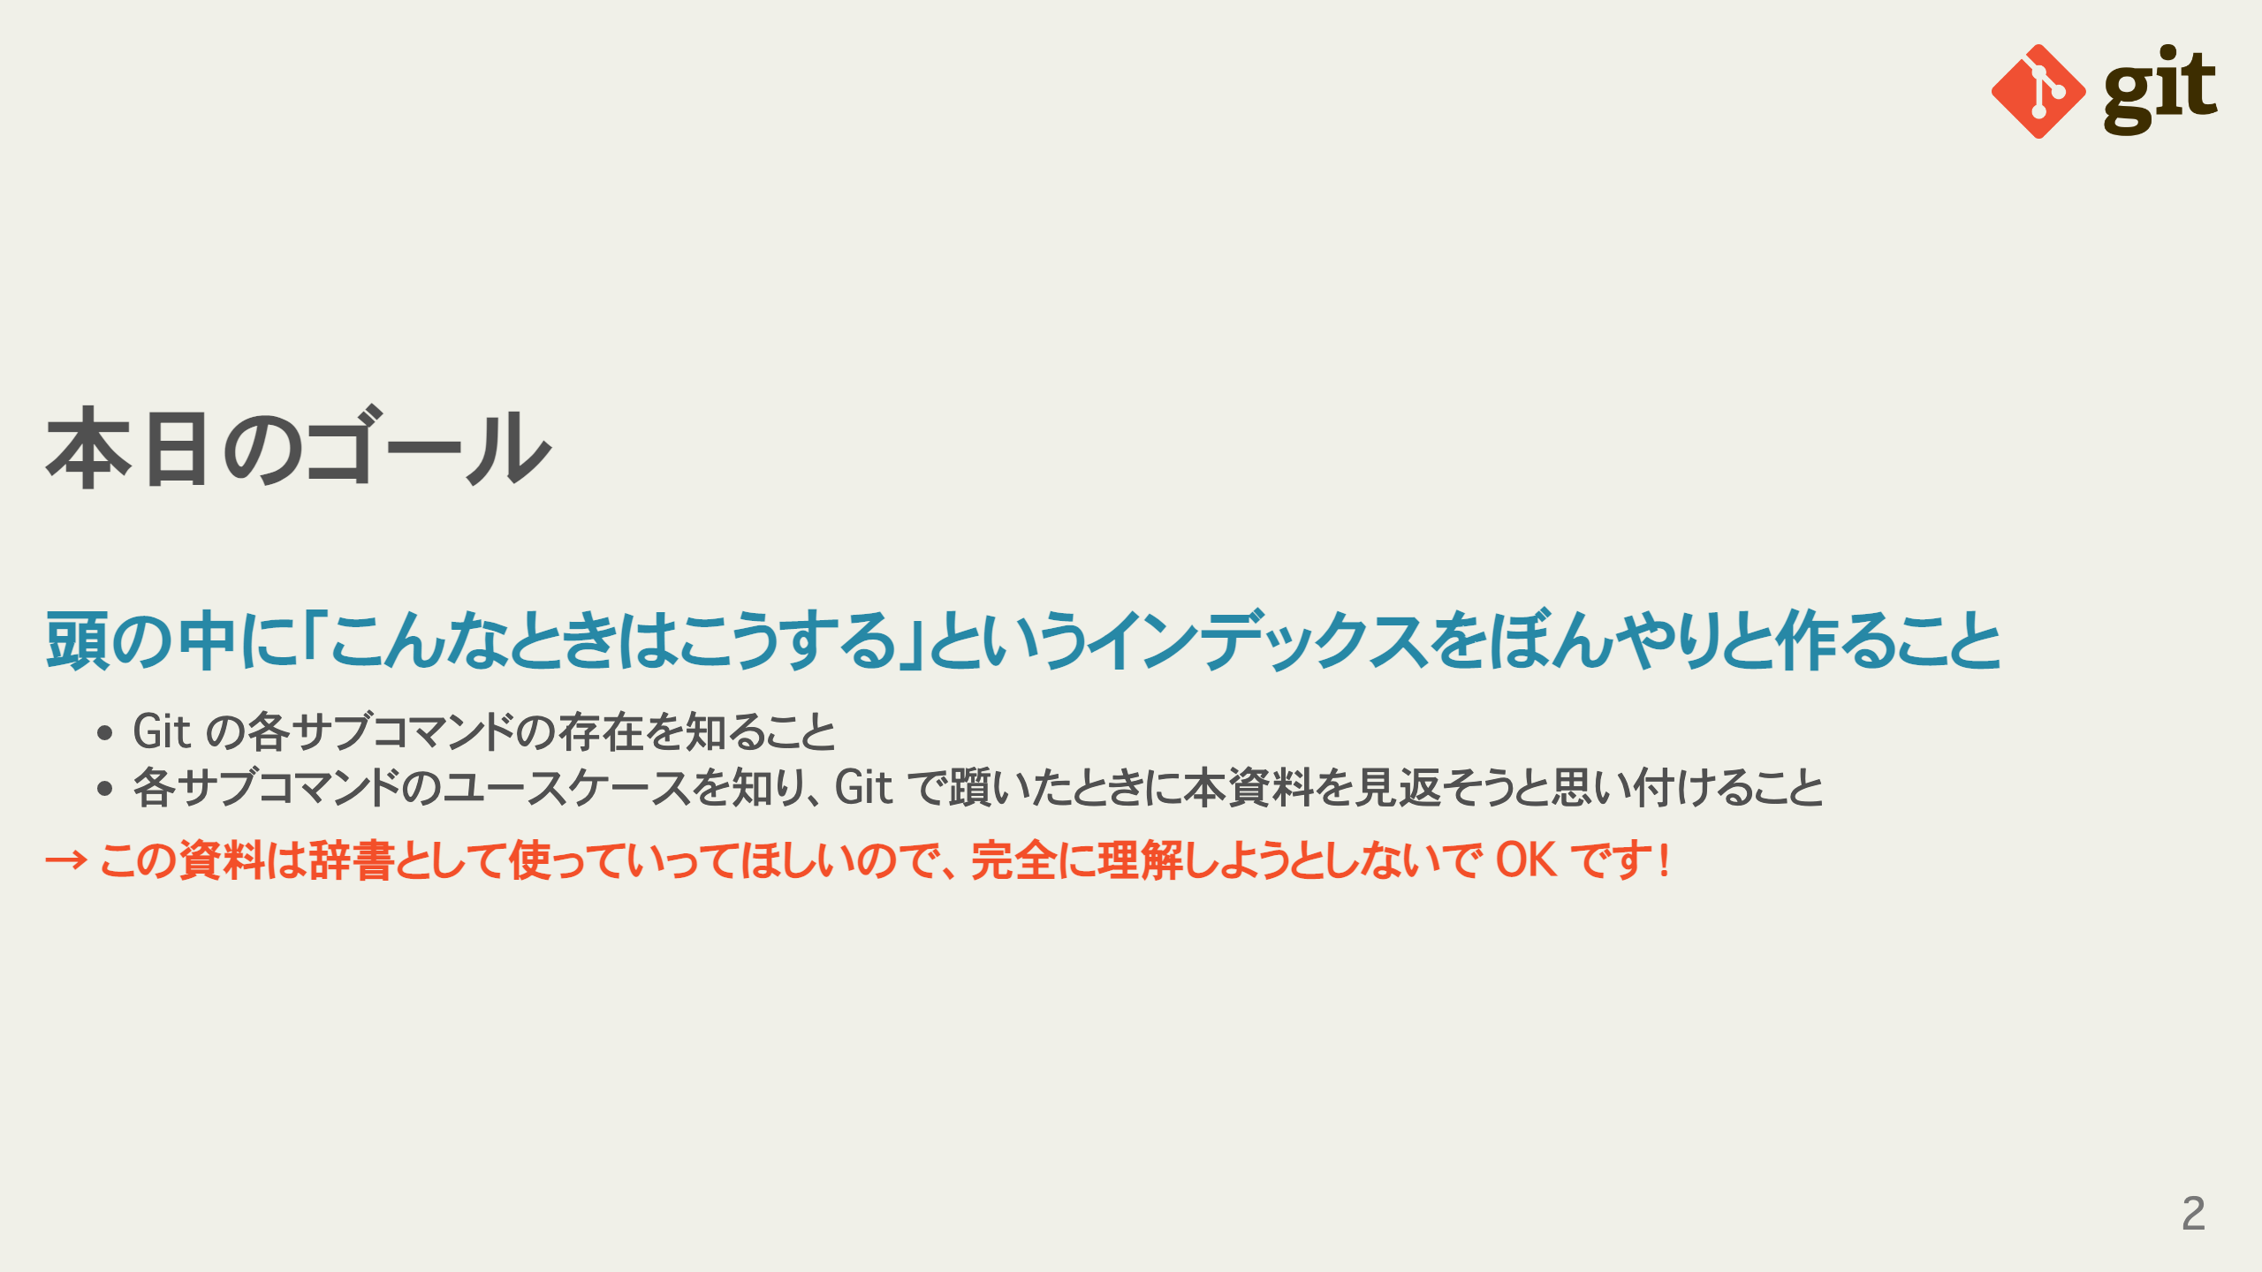
Notes:
omit in toc omit in toc

Slide 3
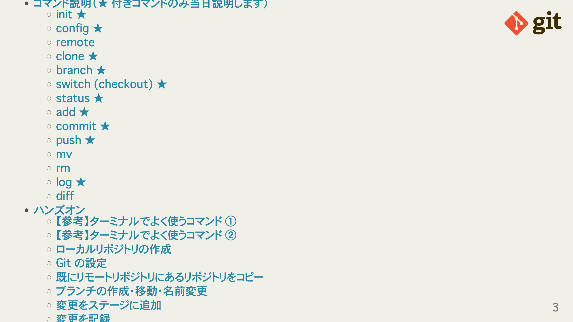

Slide 4
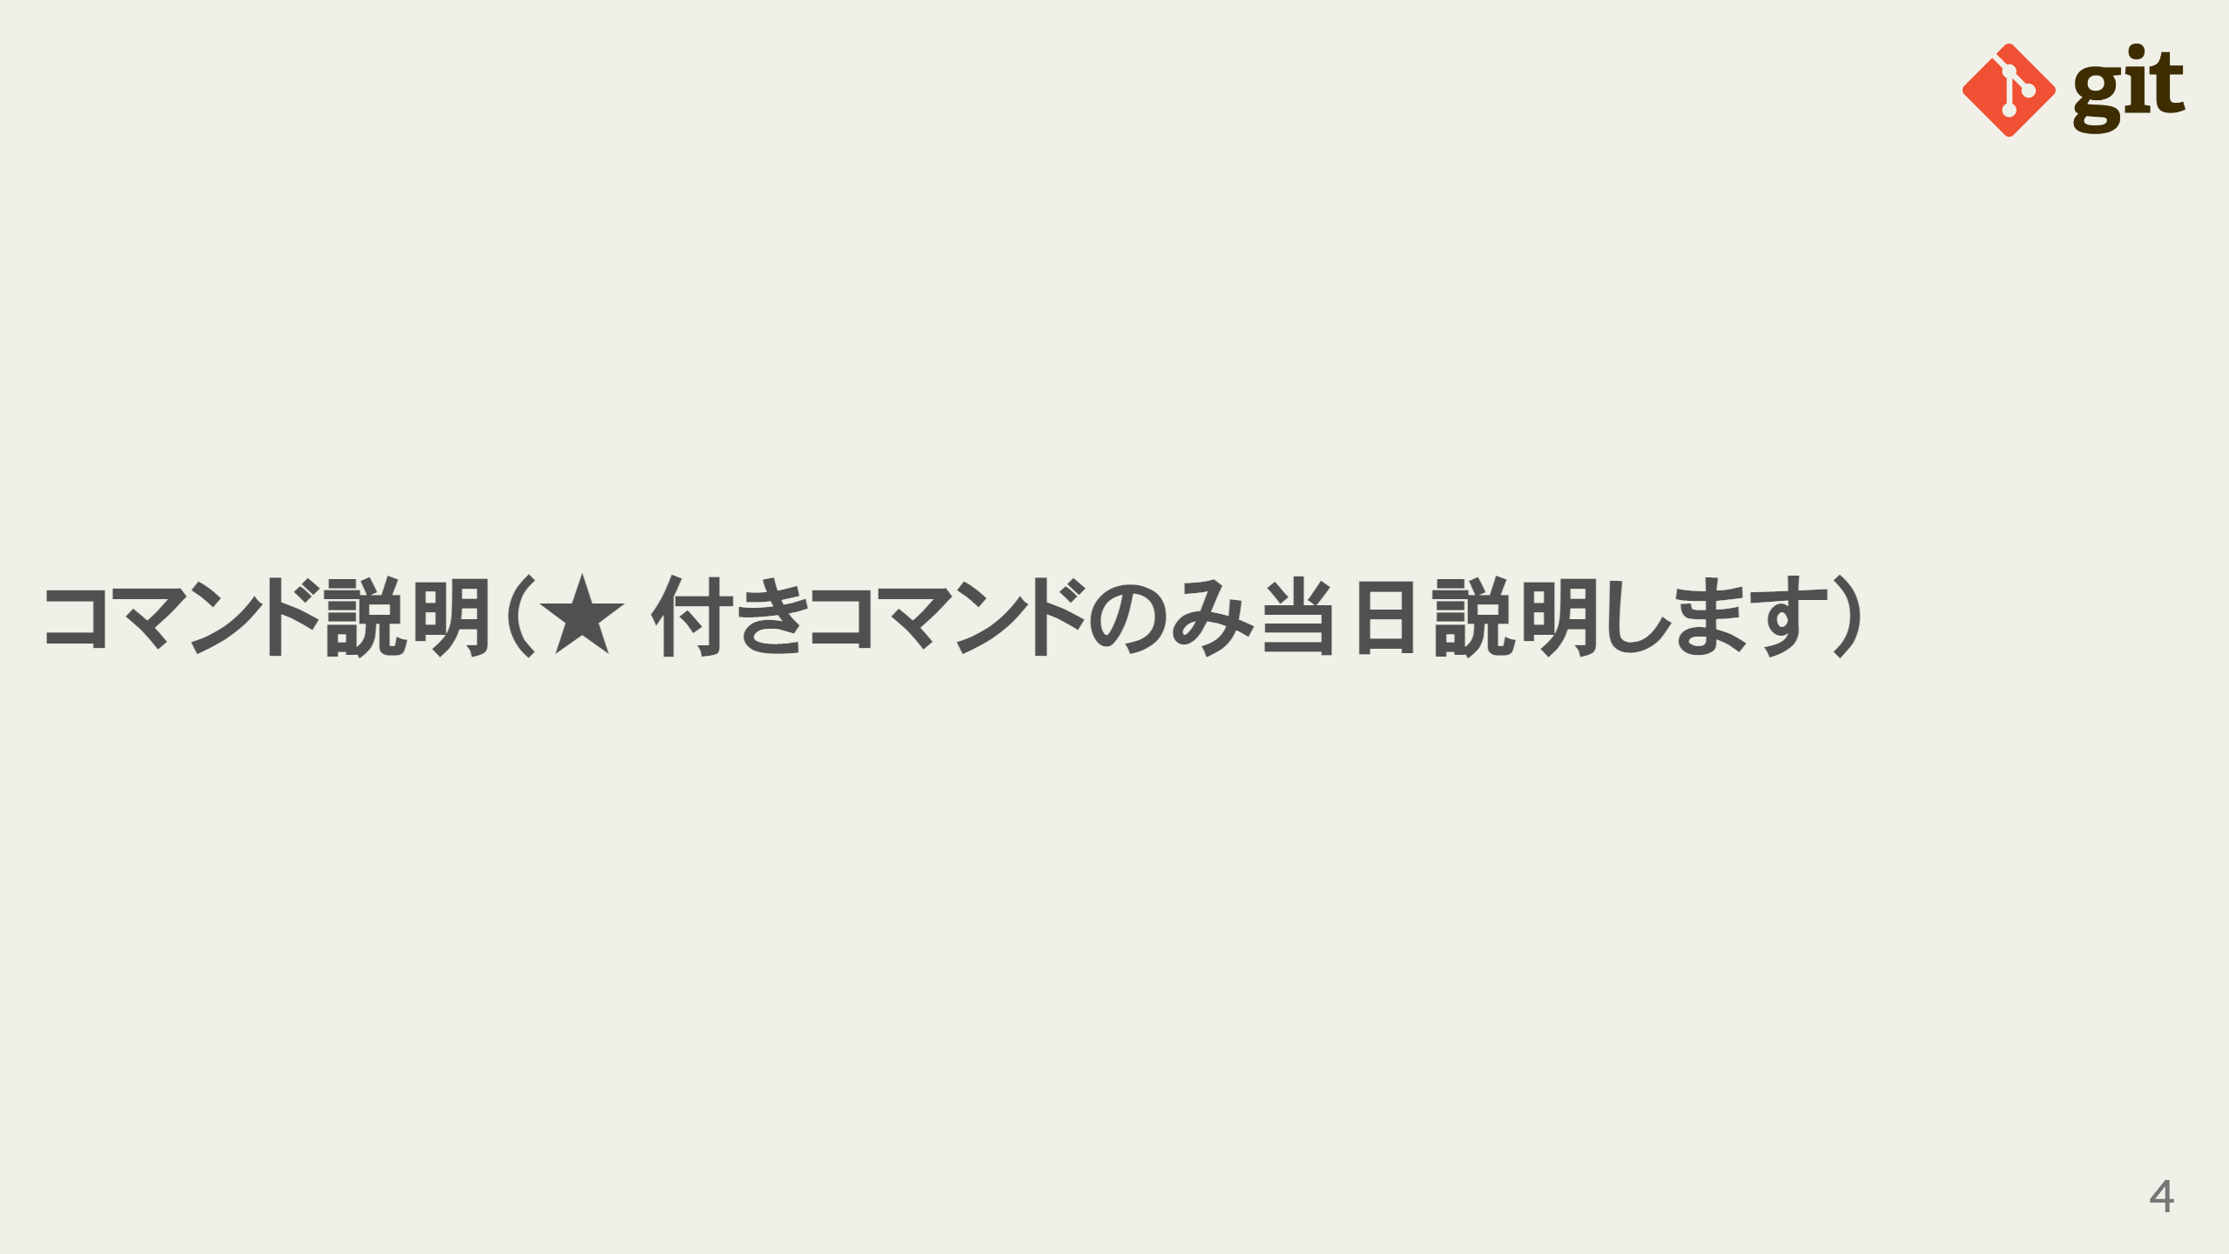

Slide 5
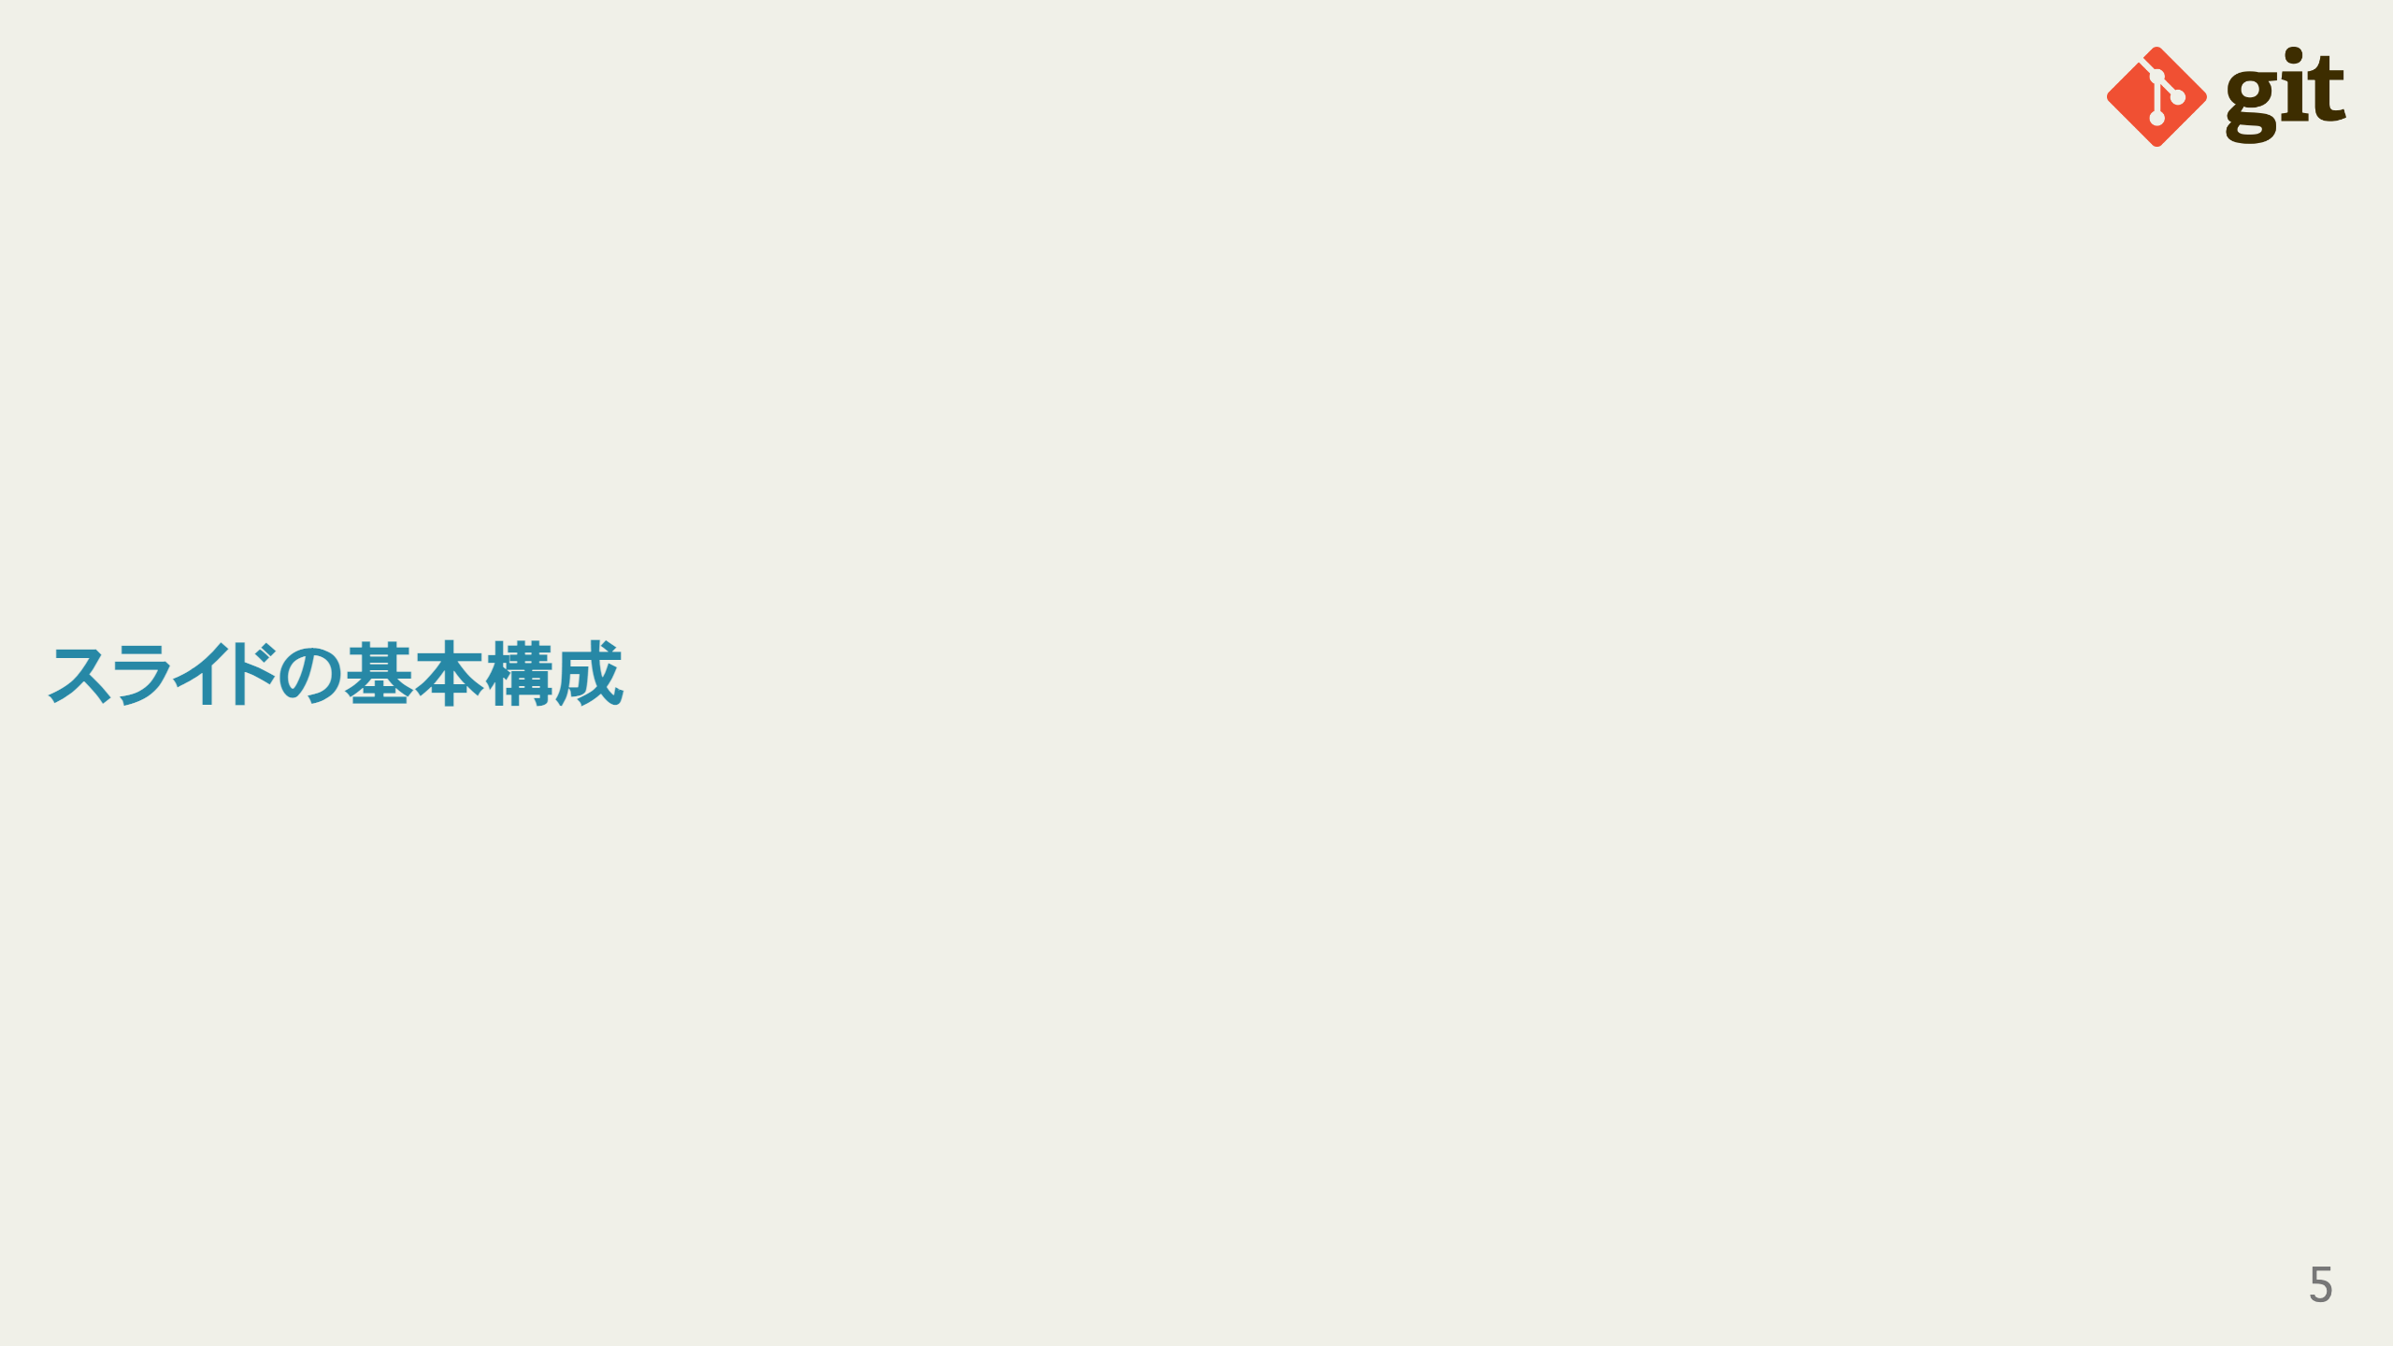
Notes:
omit in toc

Slide 6
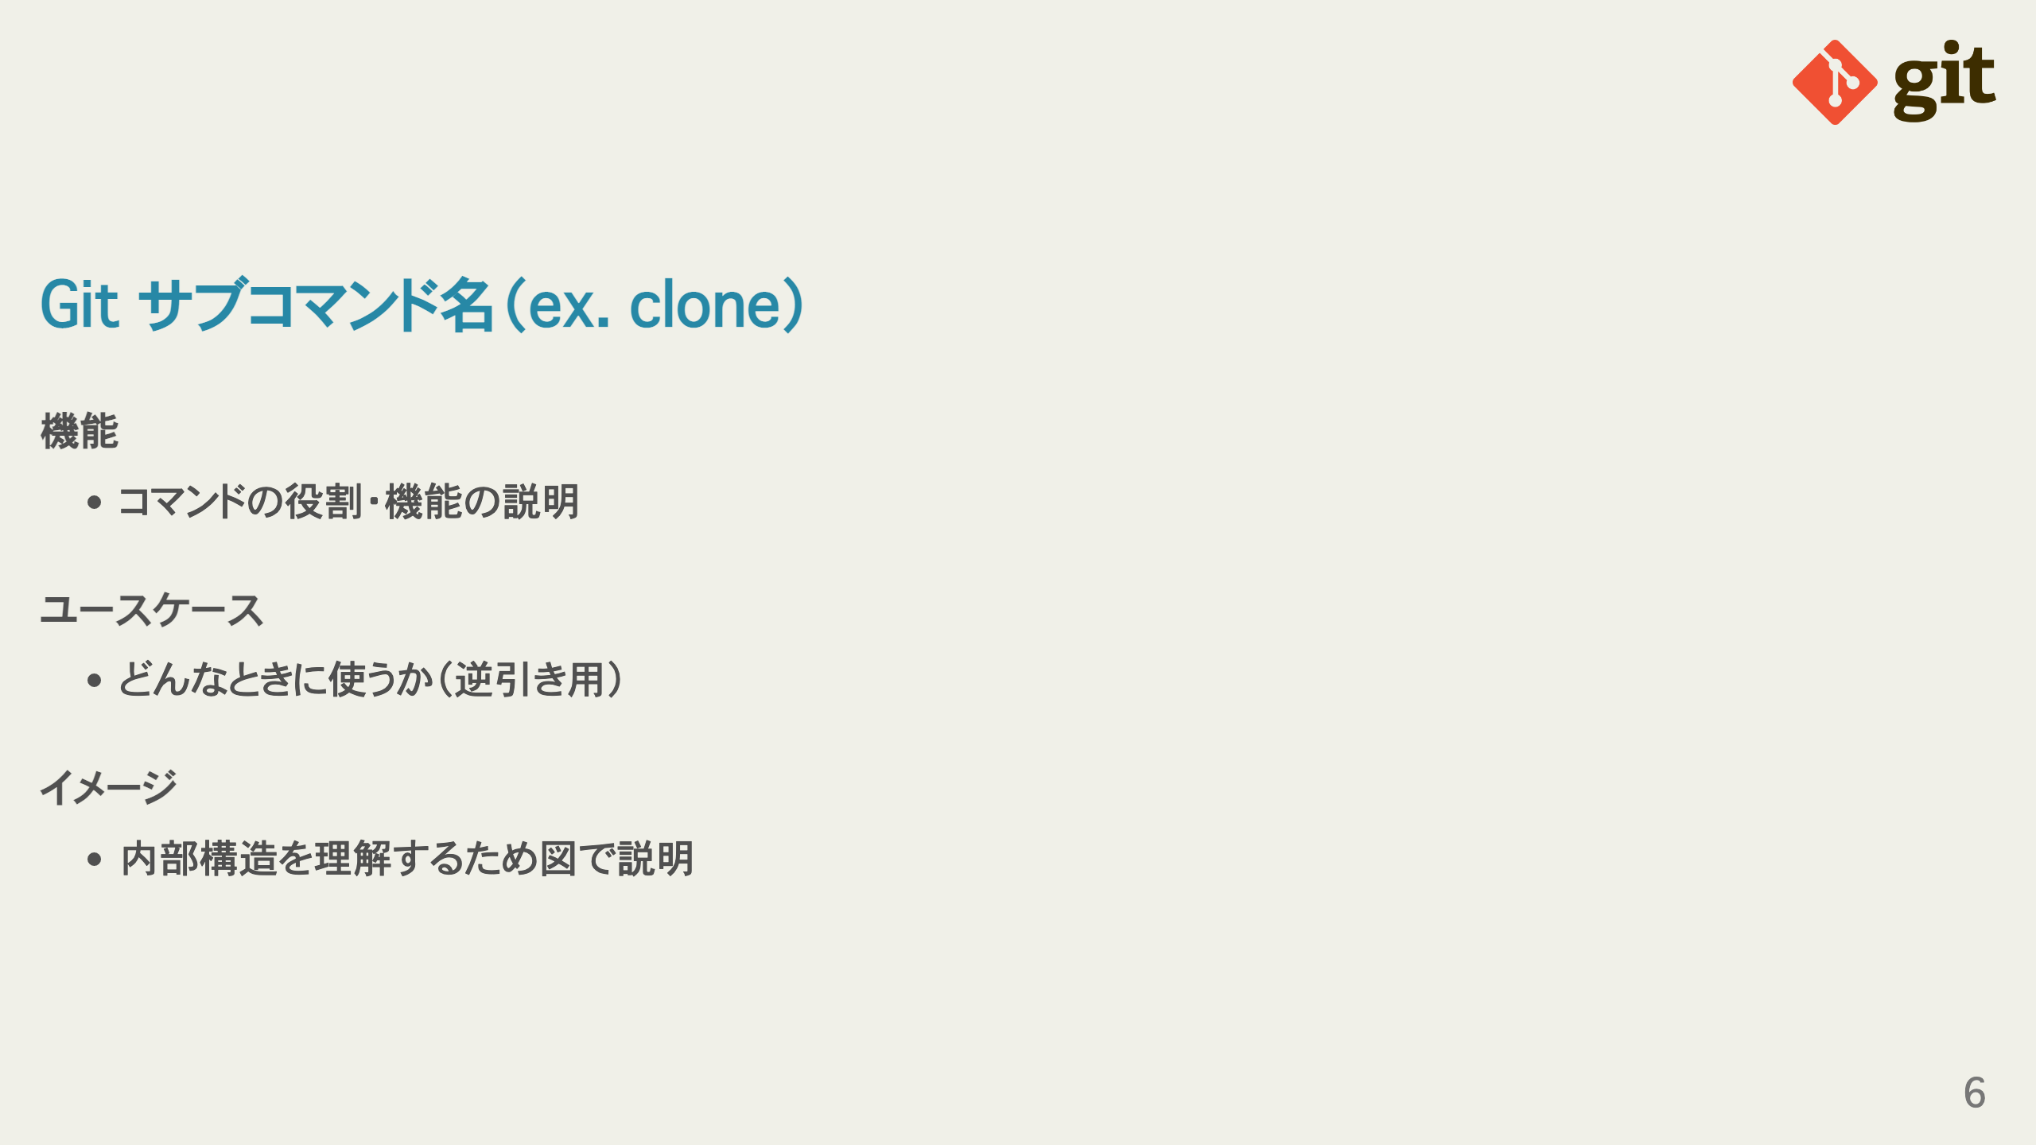
Notes:
omit in toc omit in toc omit in toc omit in toc

Slide 7
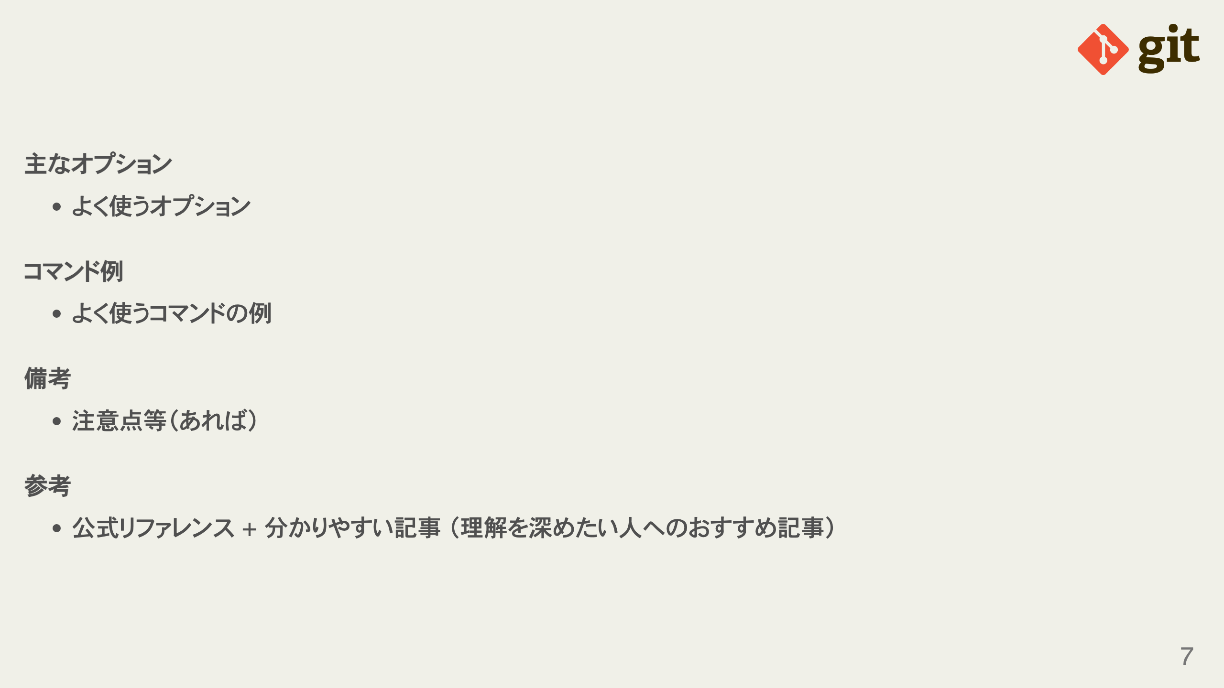
Notes:
omit in toc omit in toc omit in toc omit in toc

Slide 8
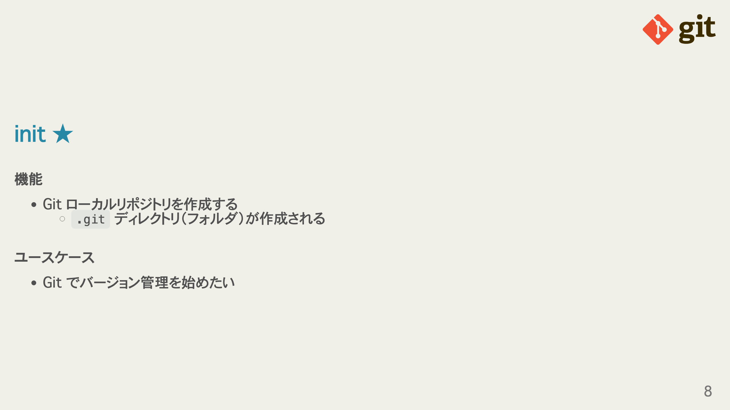
Notes:
omit in toc omit in toc

Slide 9
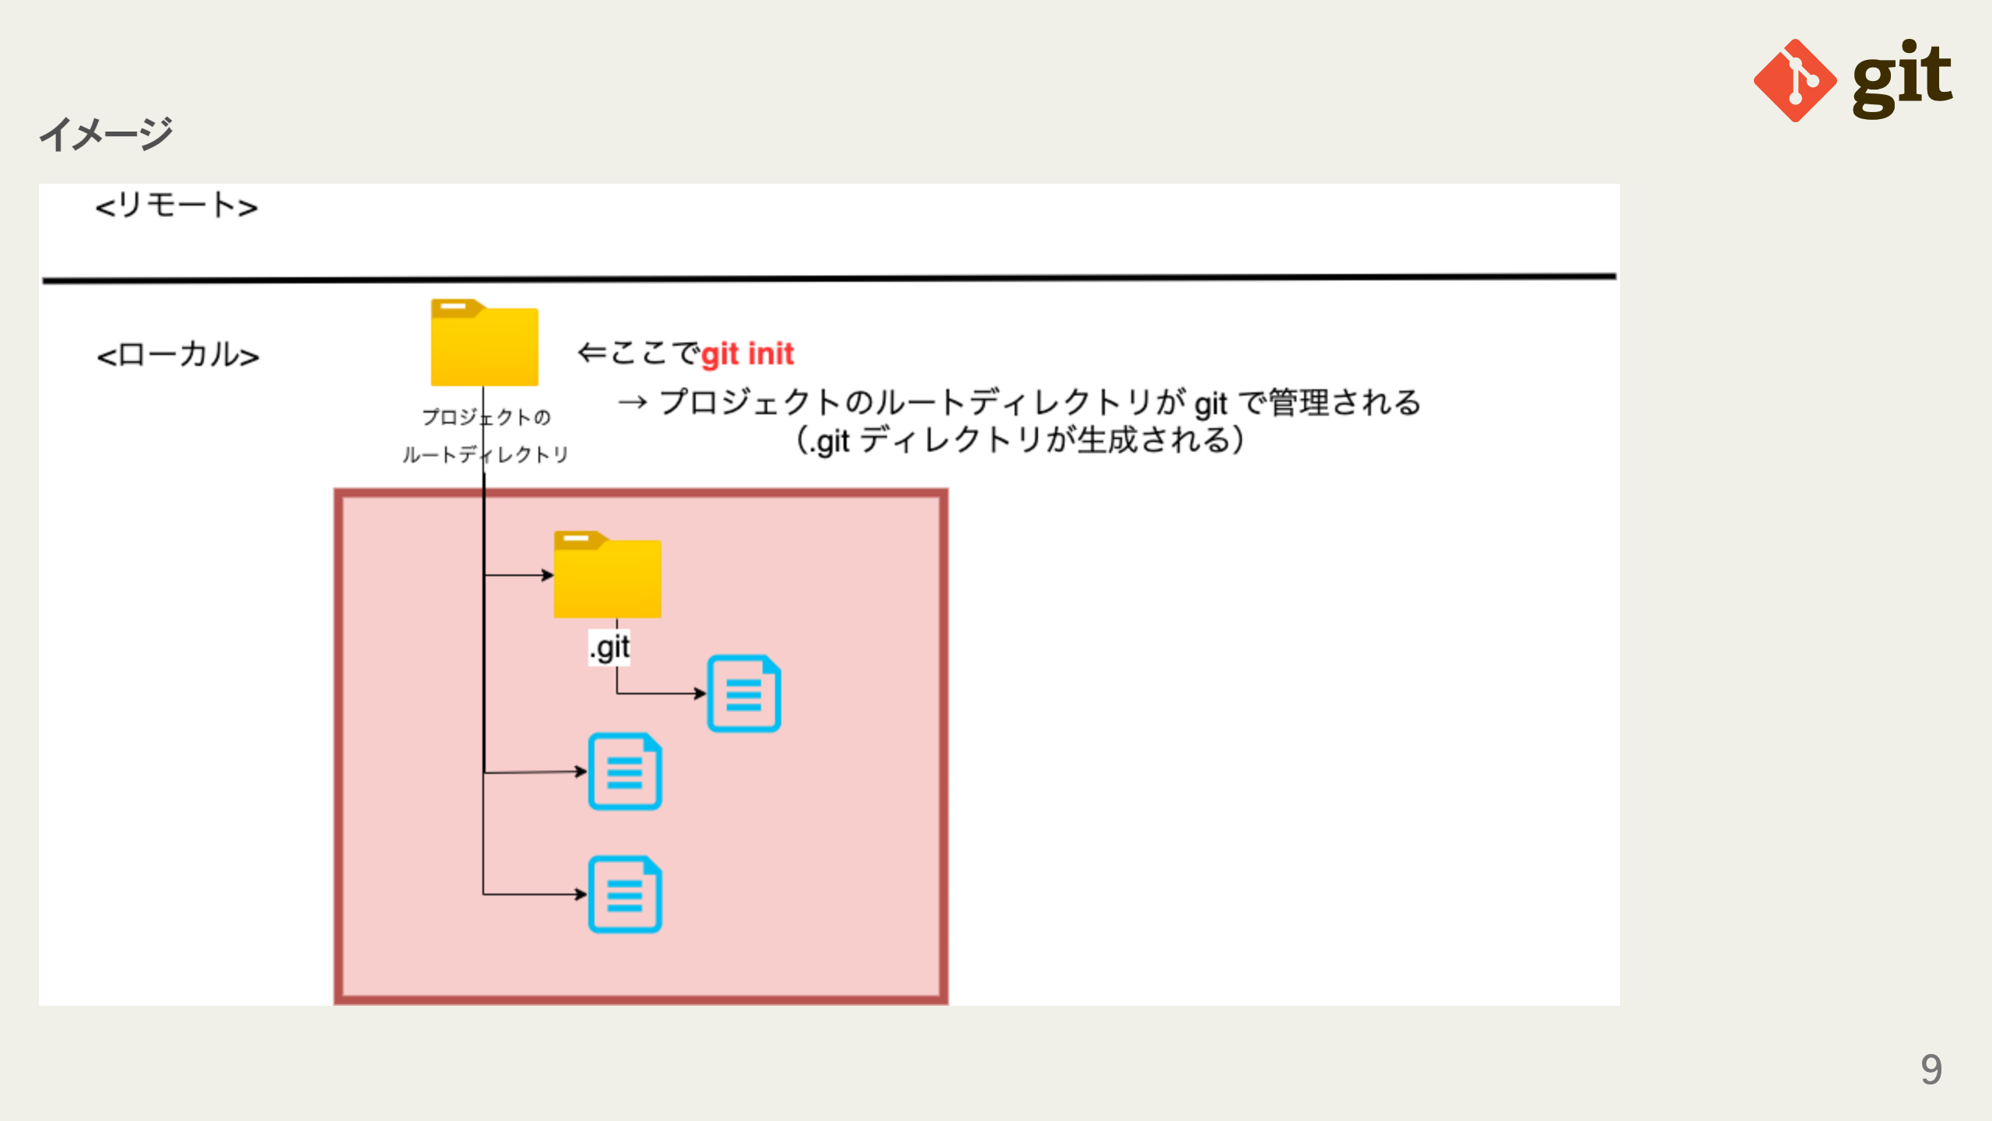
Notes:
omit in toc

Slide 10
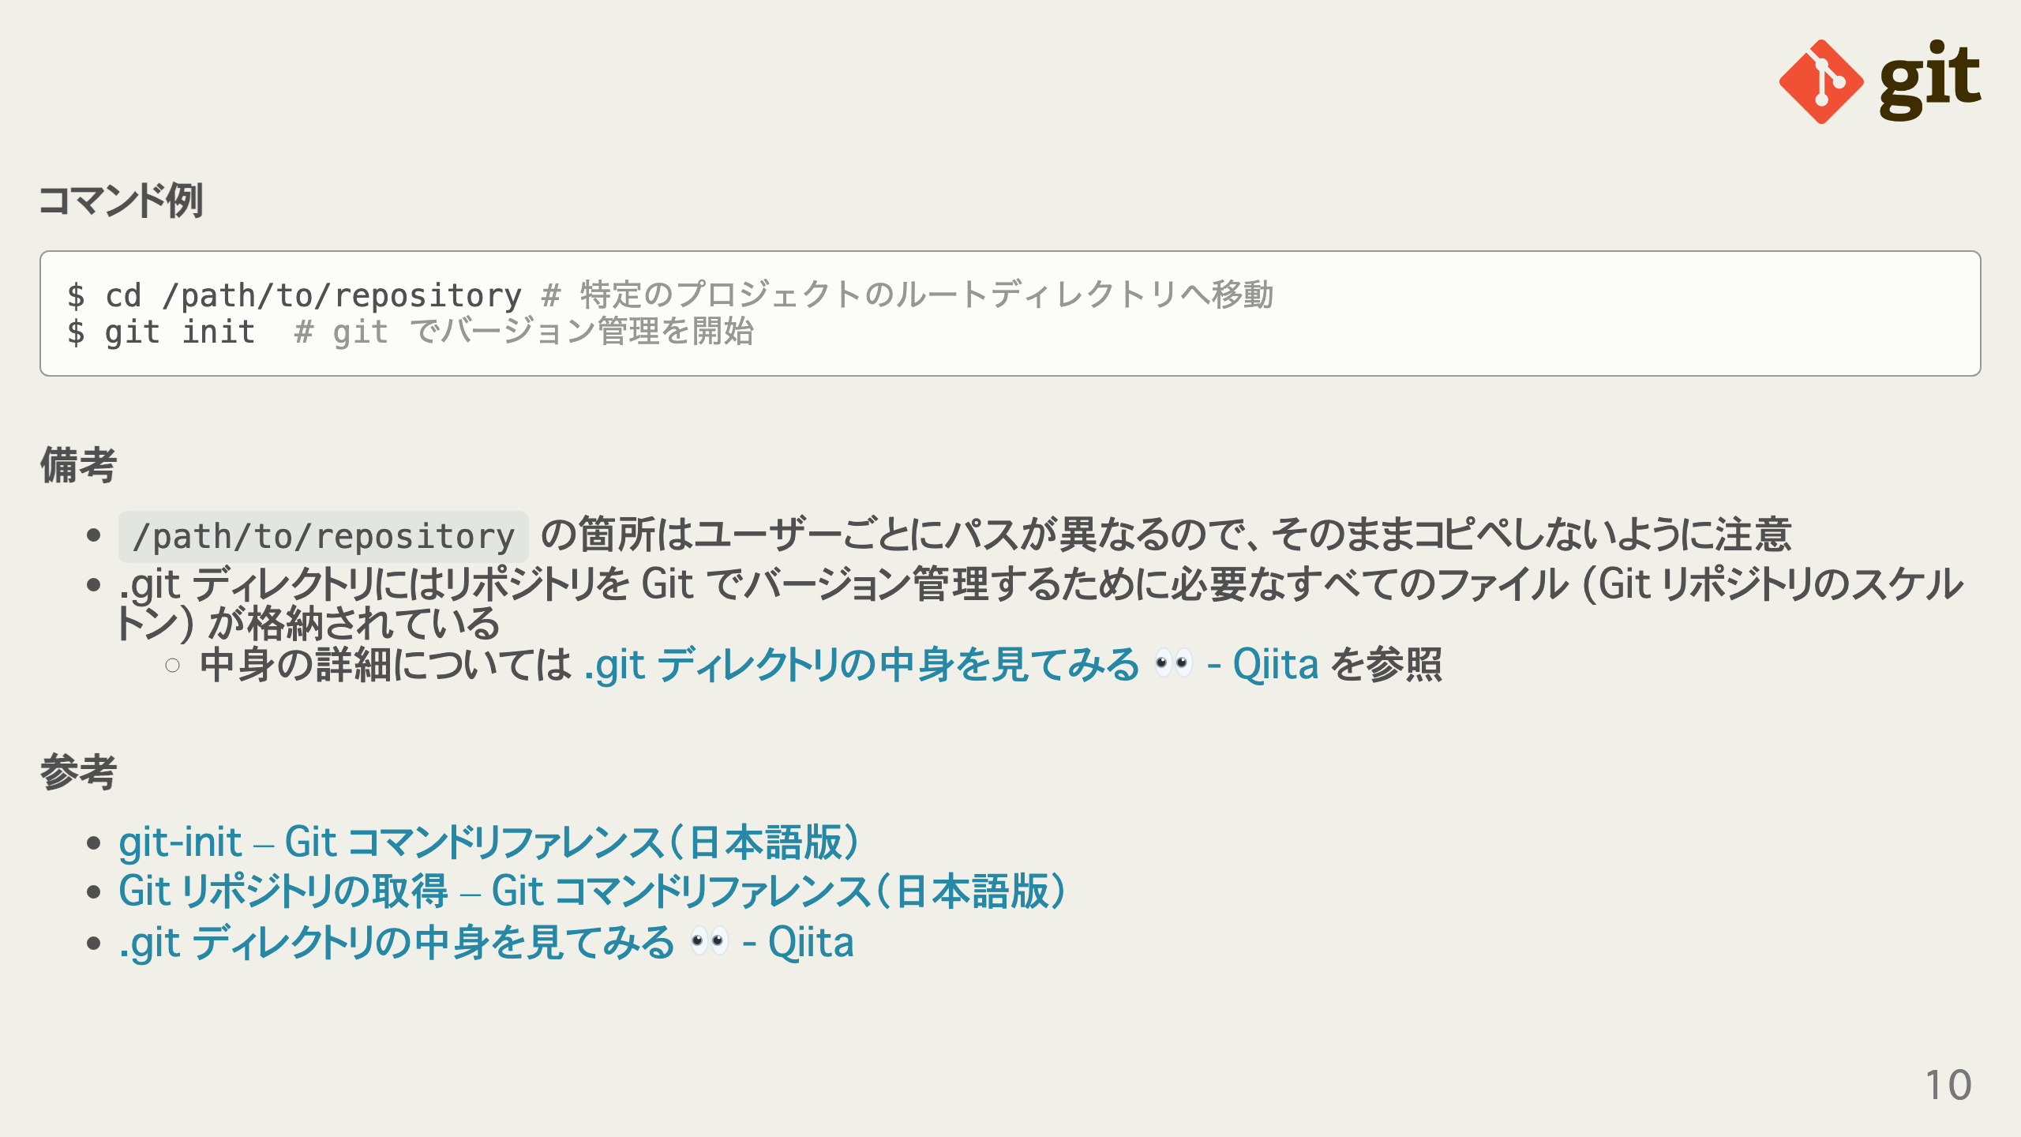
Notes:
omit in toc omit in toc omit in toc

Slide 11
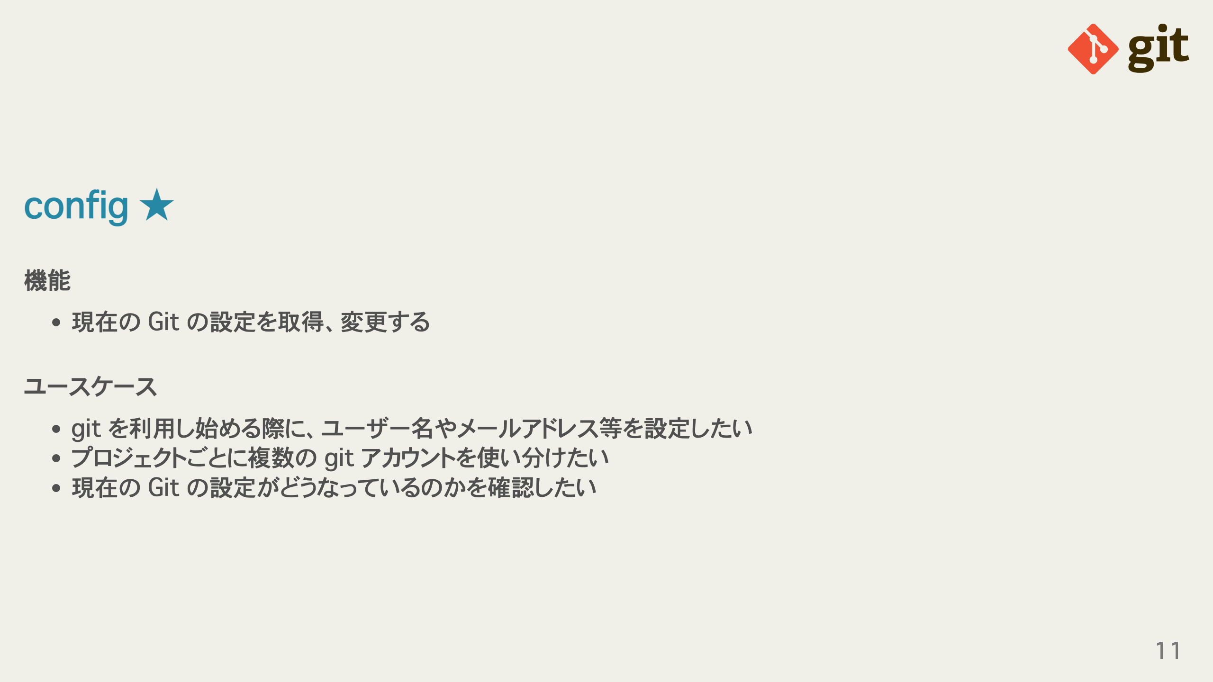
Notes:
omit in toc omit in toc

Slide 12
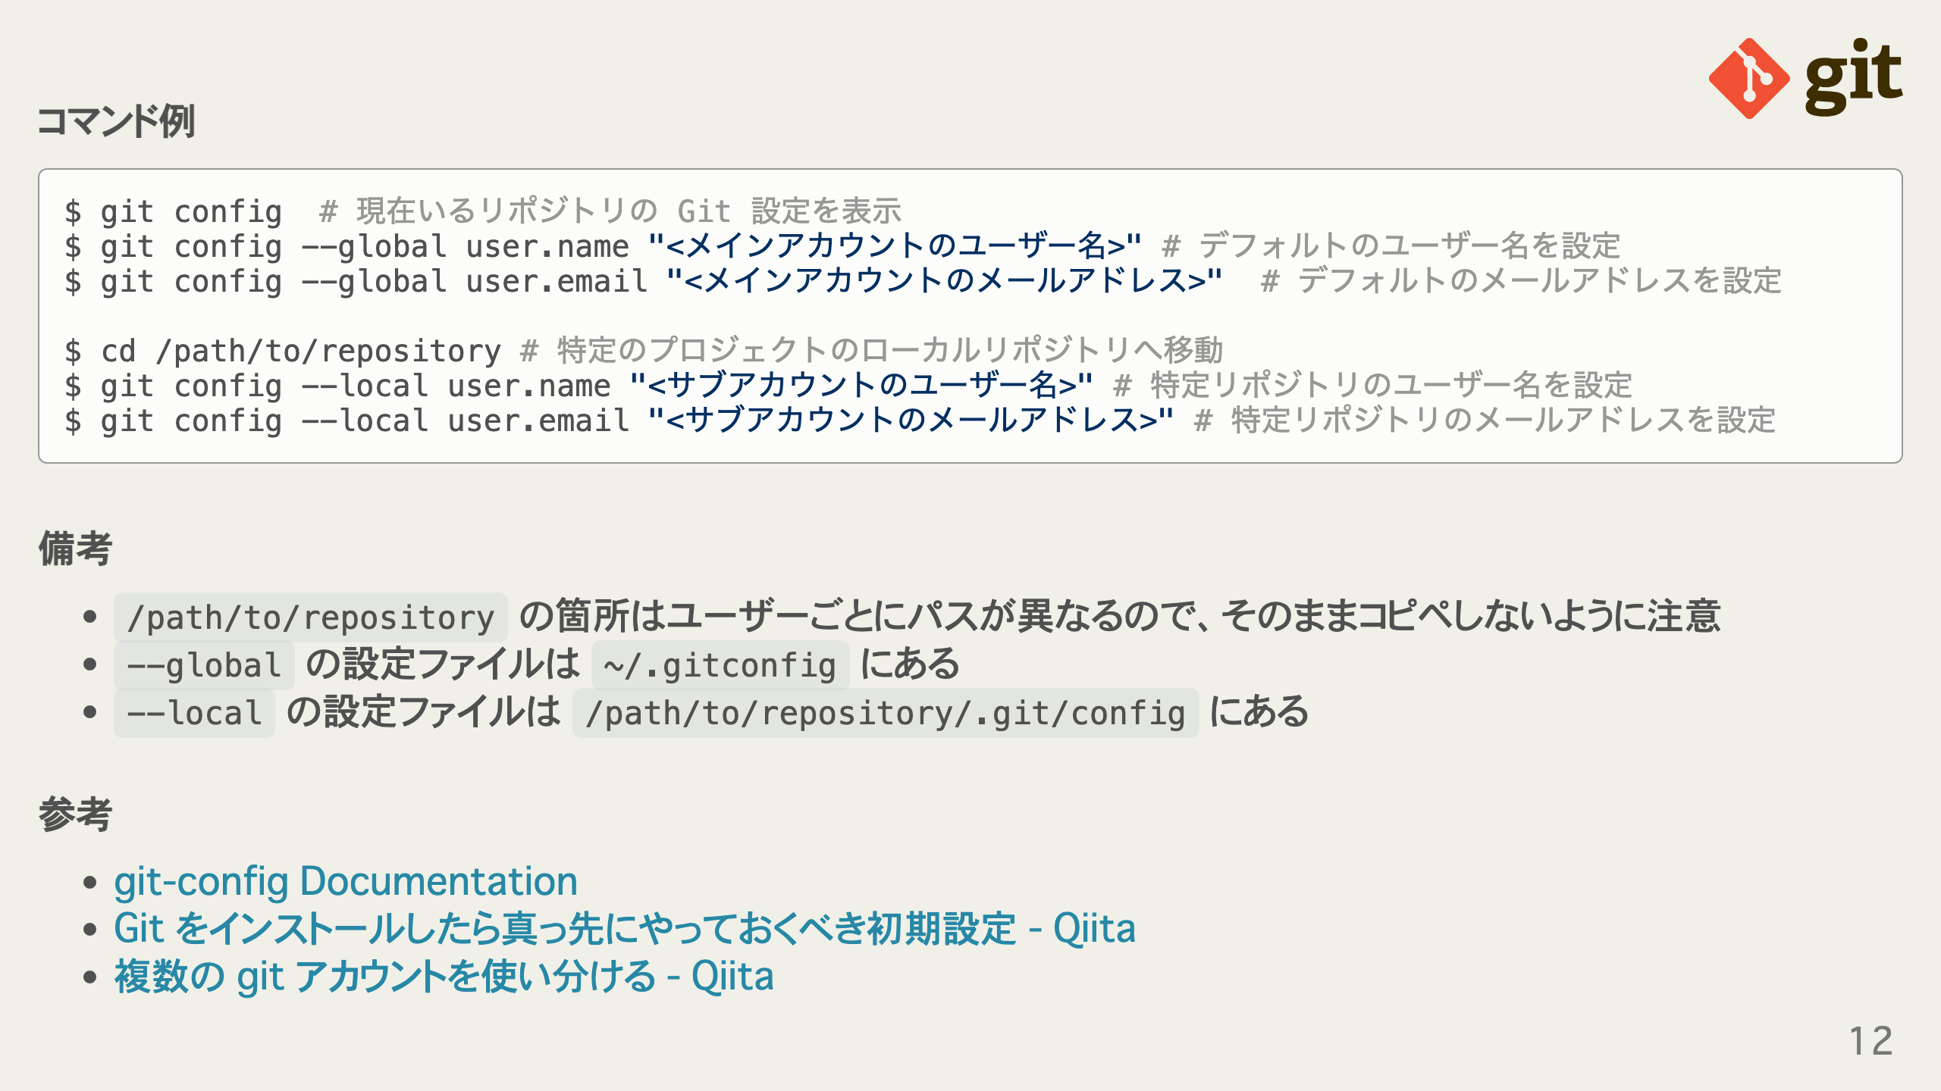
Notes:
omit in toc omit in toc omit in toc

Slide 13
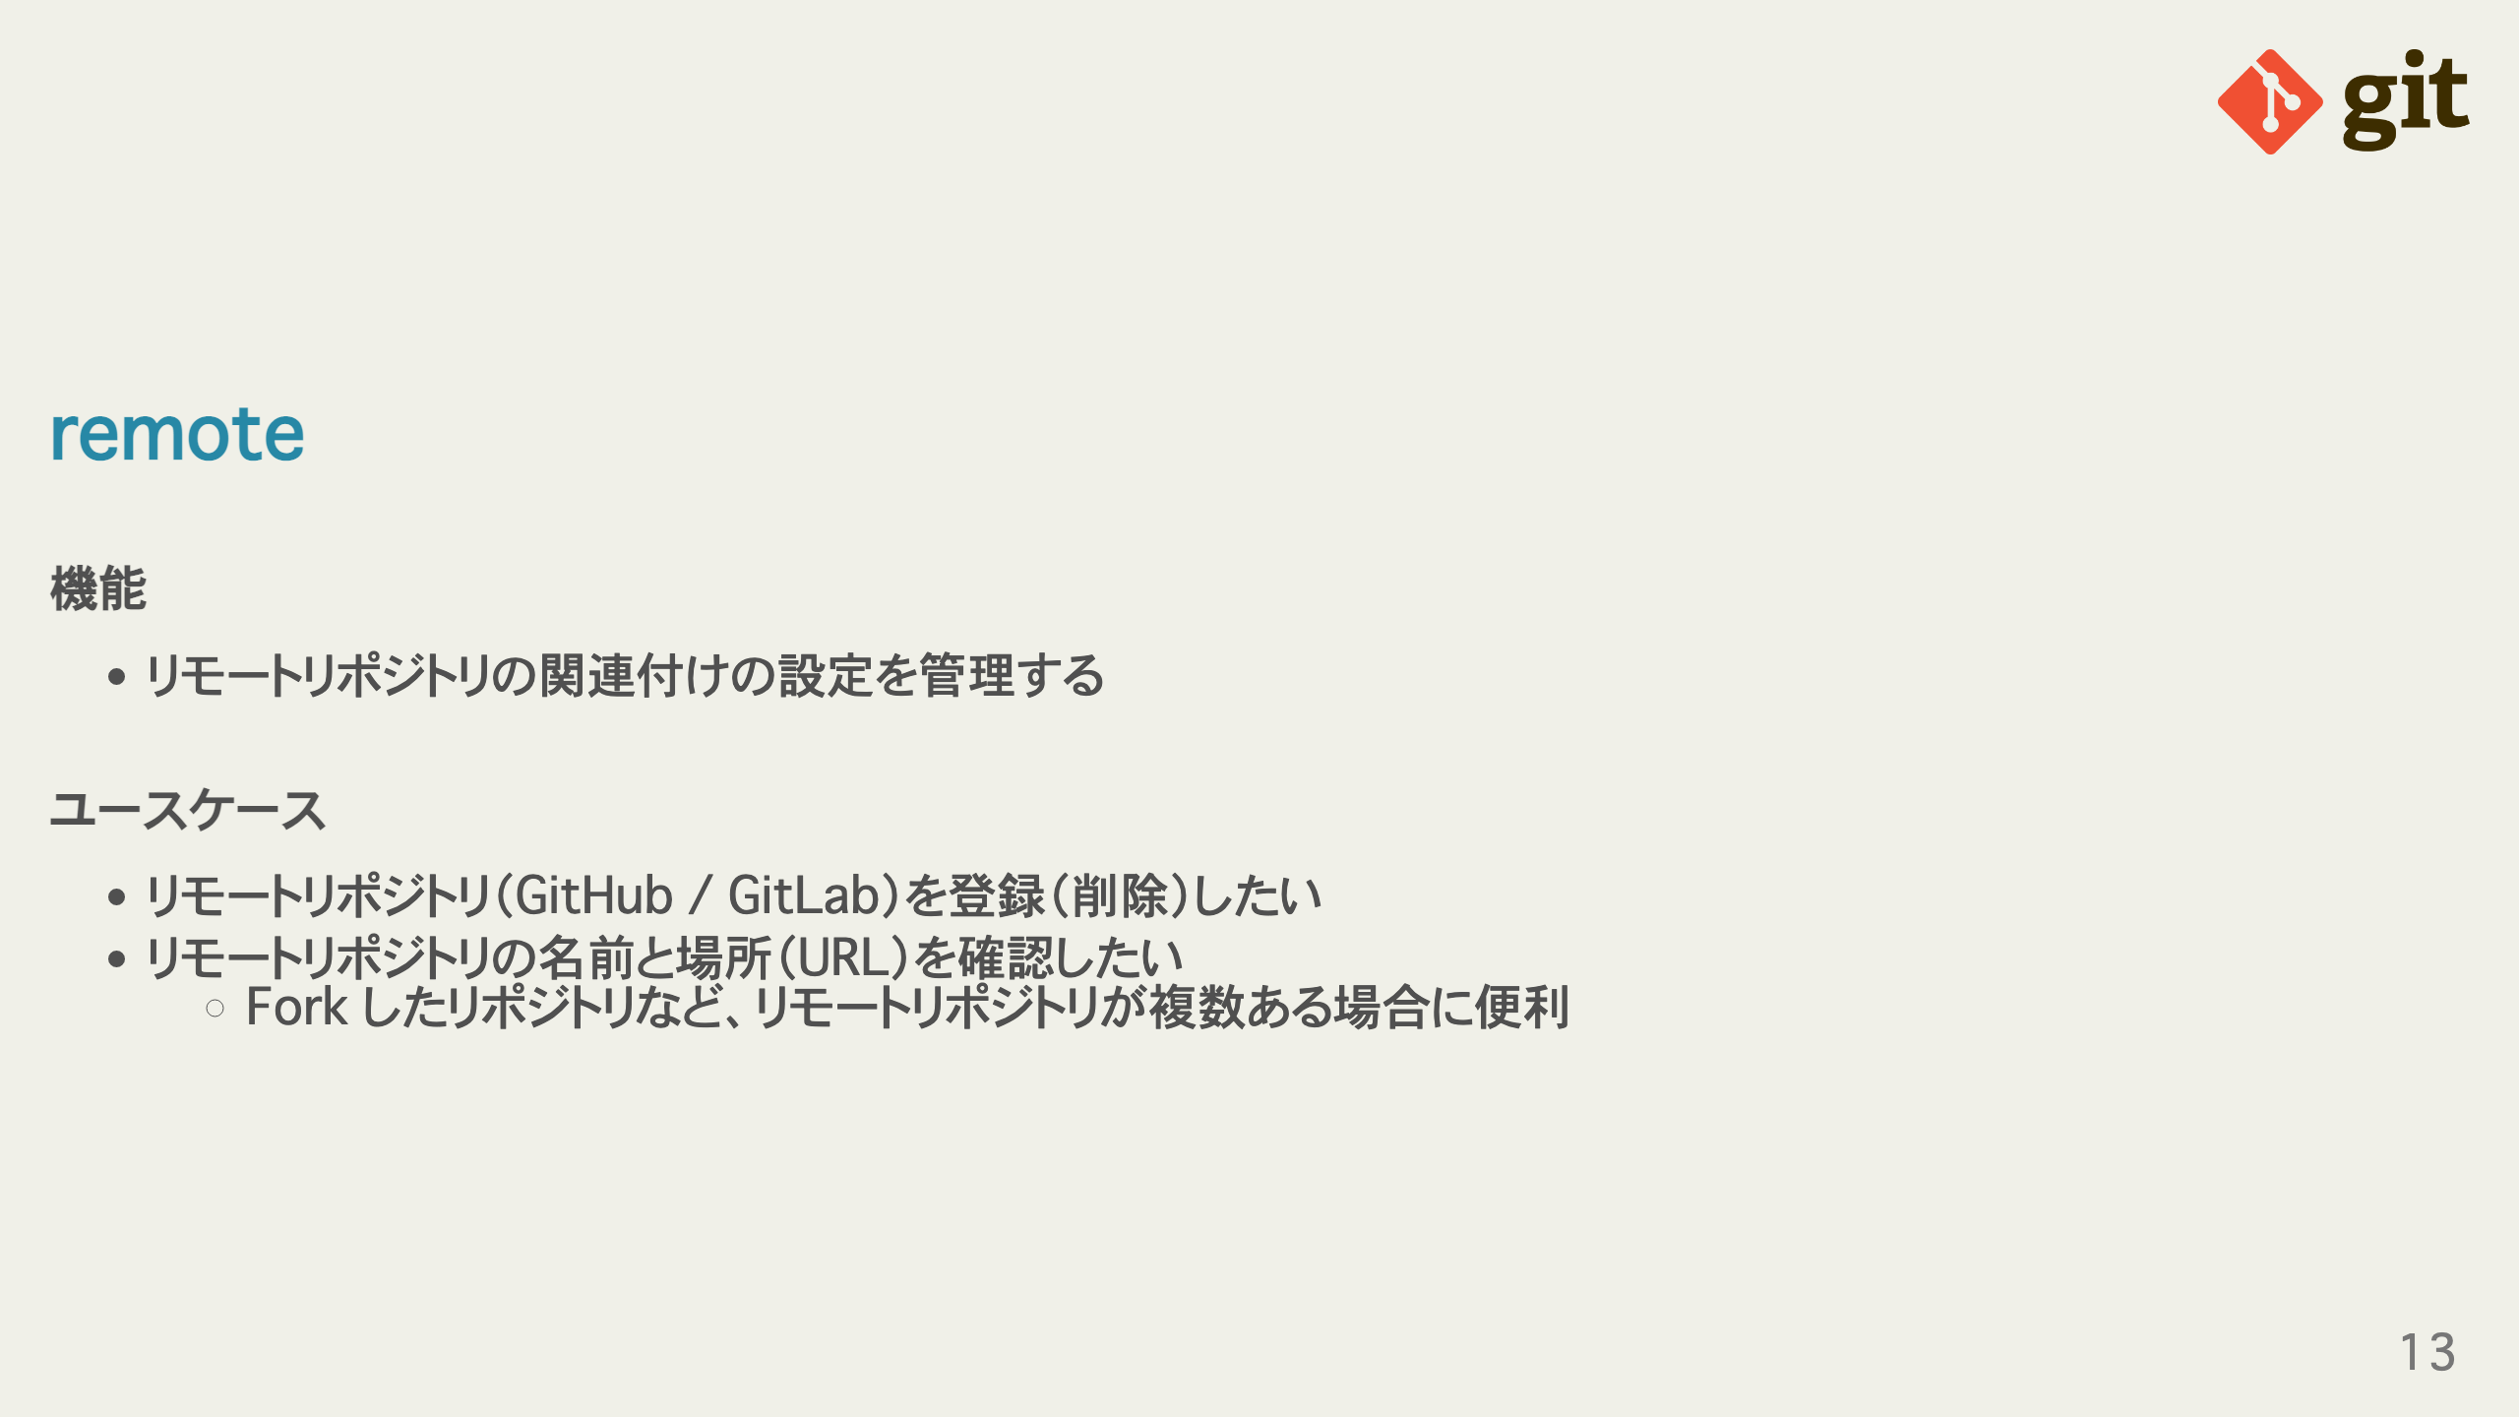
Notes:
omit in toc omit in toc

Slide 14
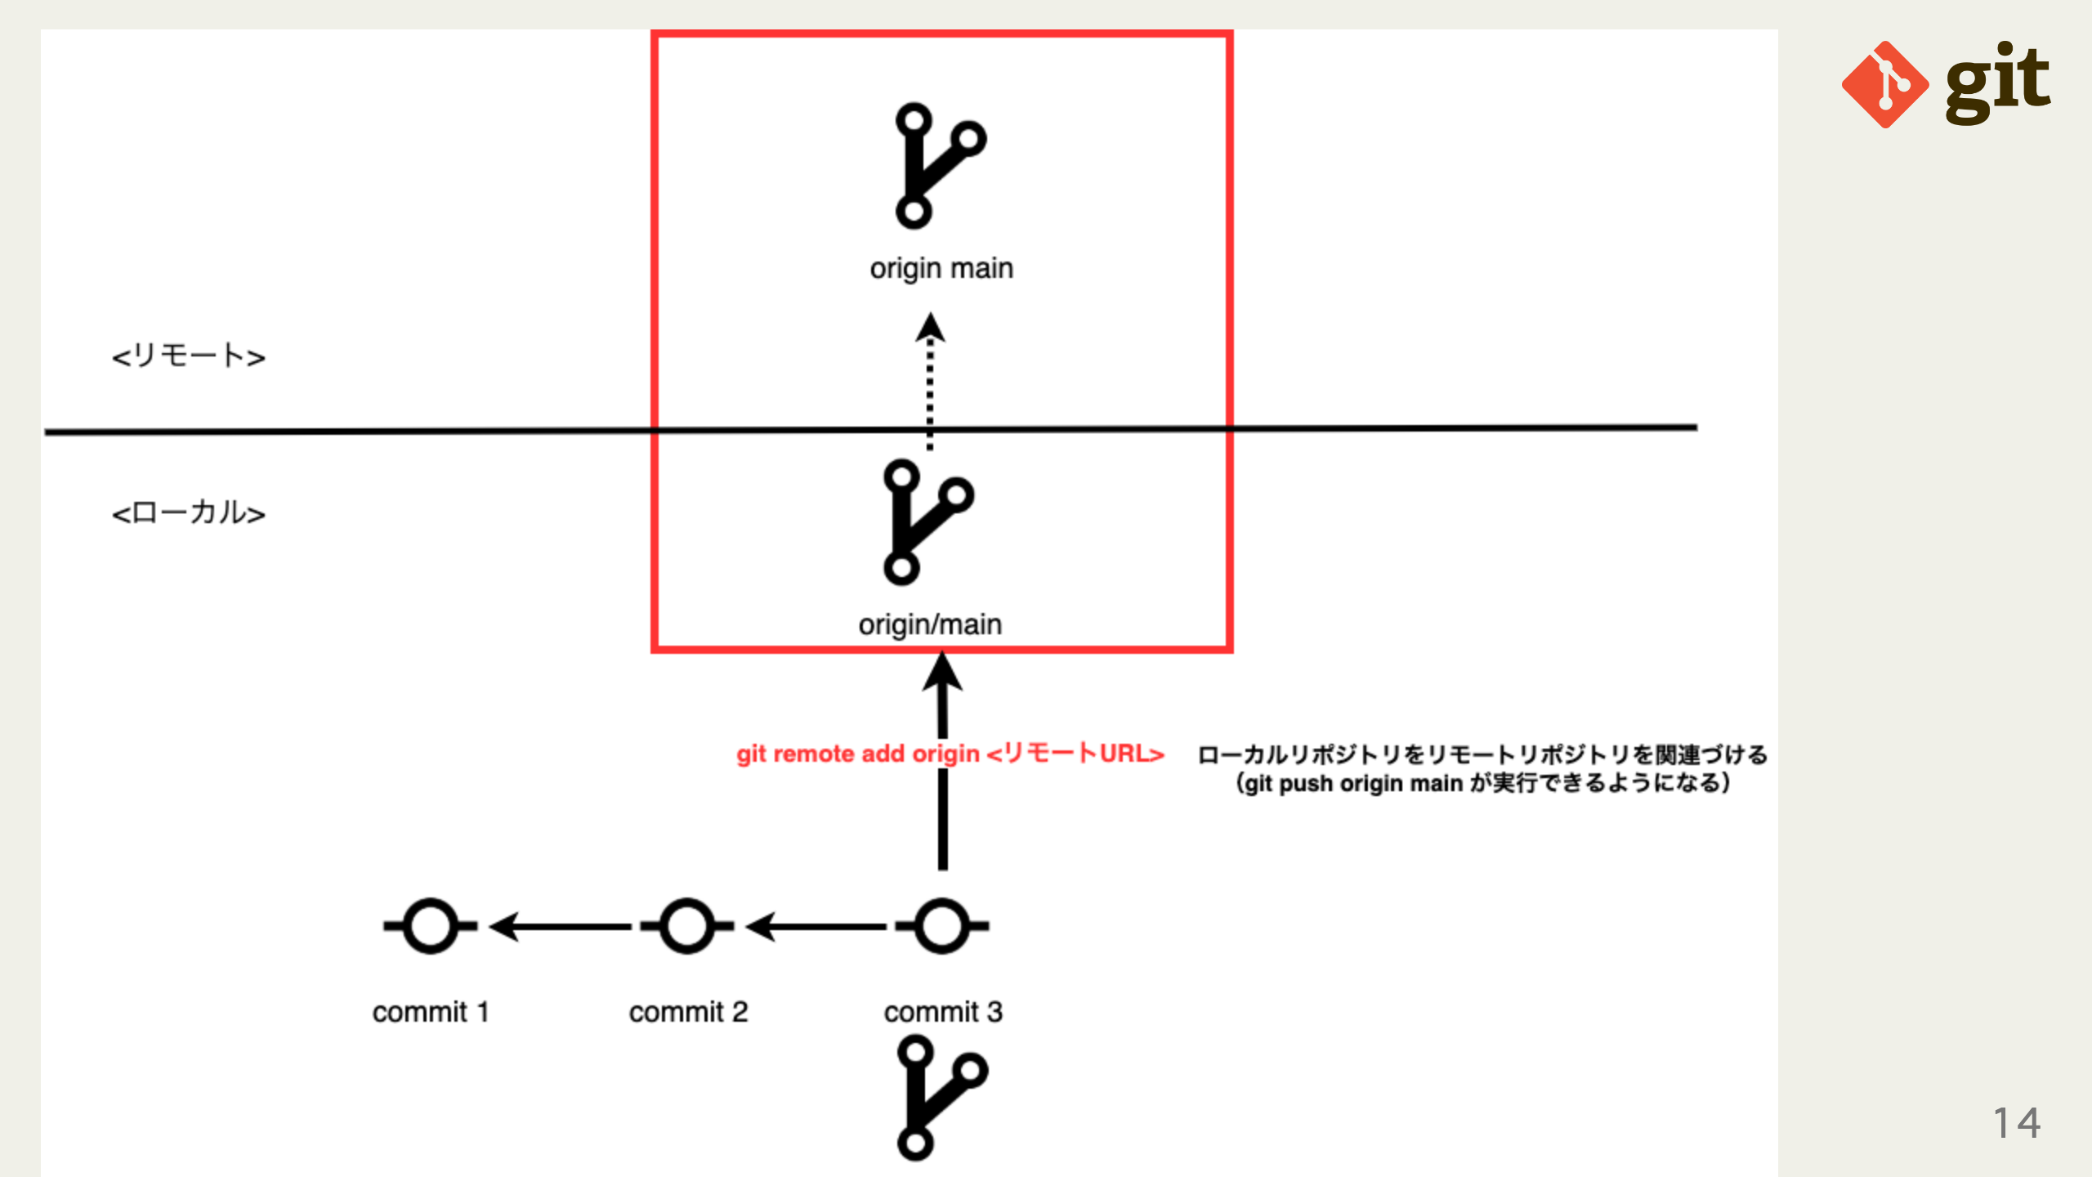
Notes:
omit in toc

Slide 15
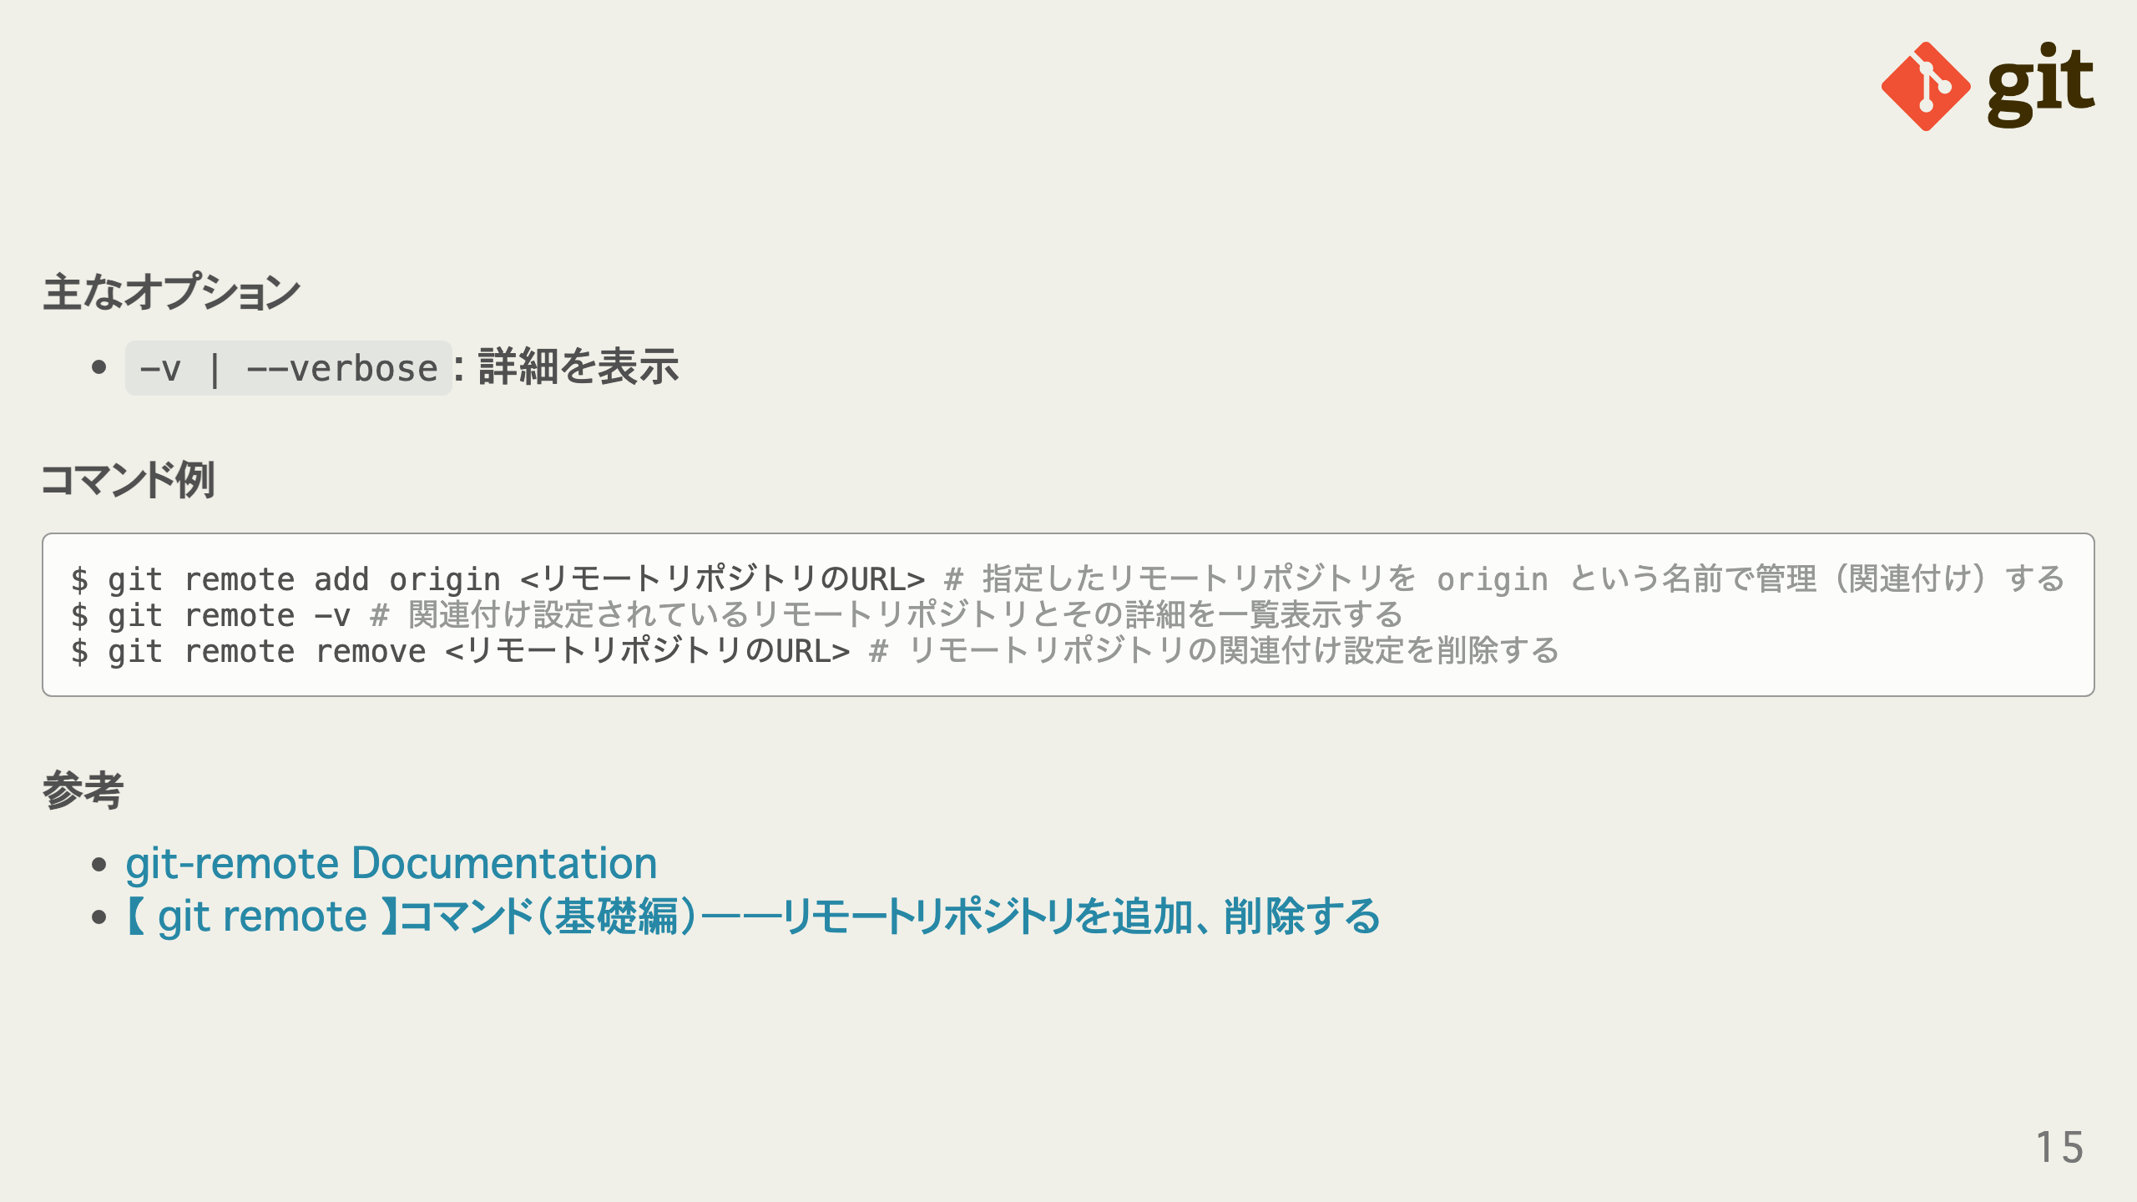
Notes:
omit in toc omit in toc omit in toc

Slide 16
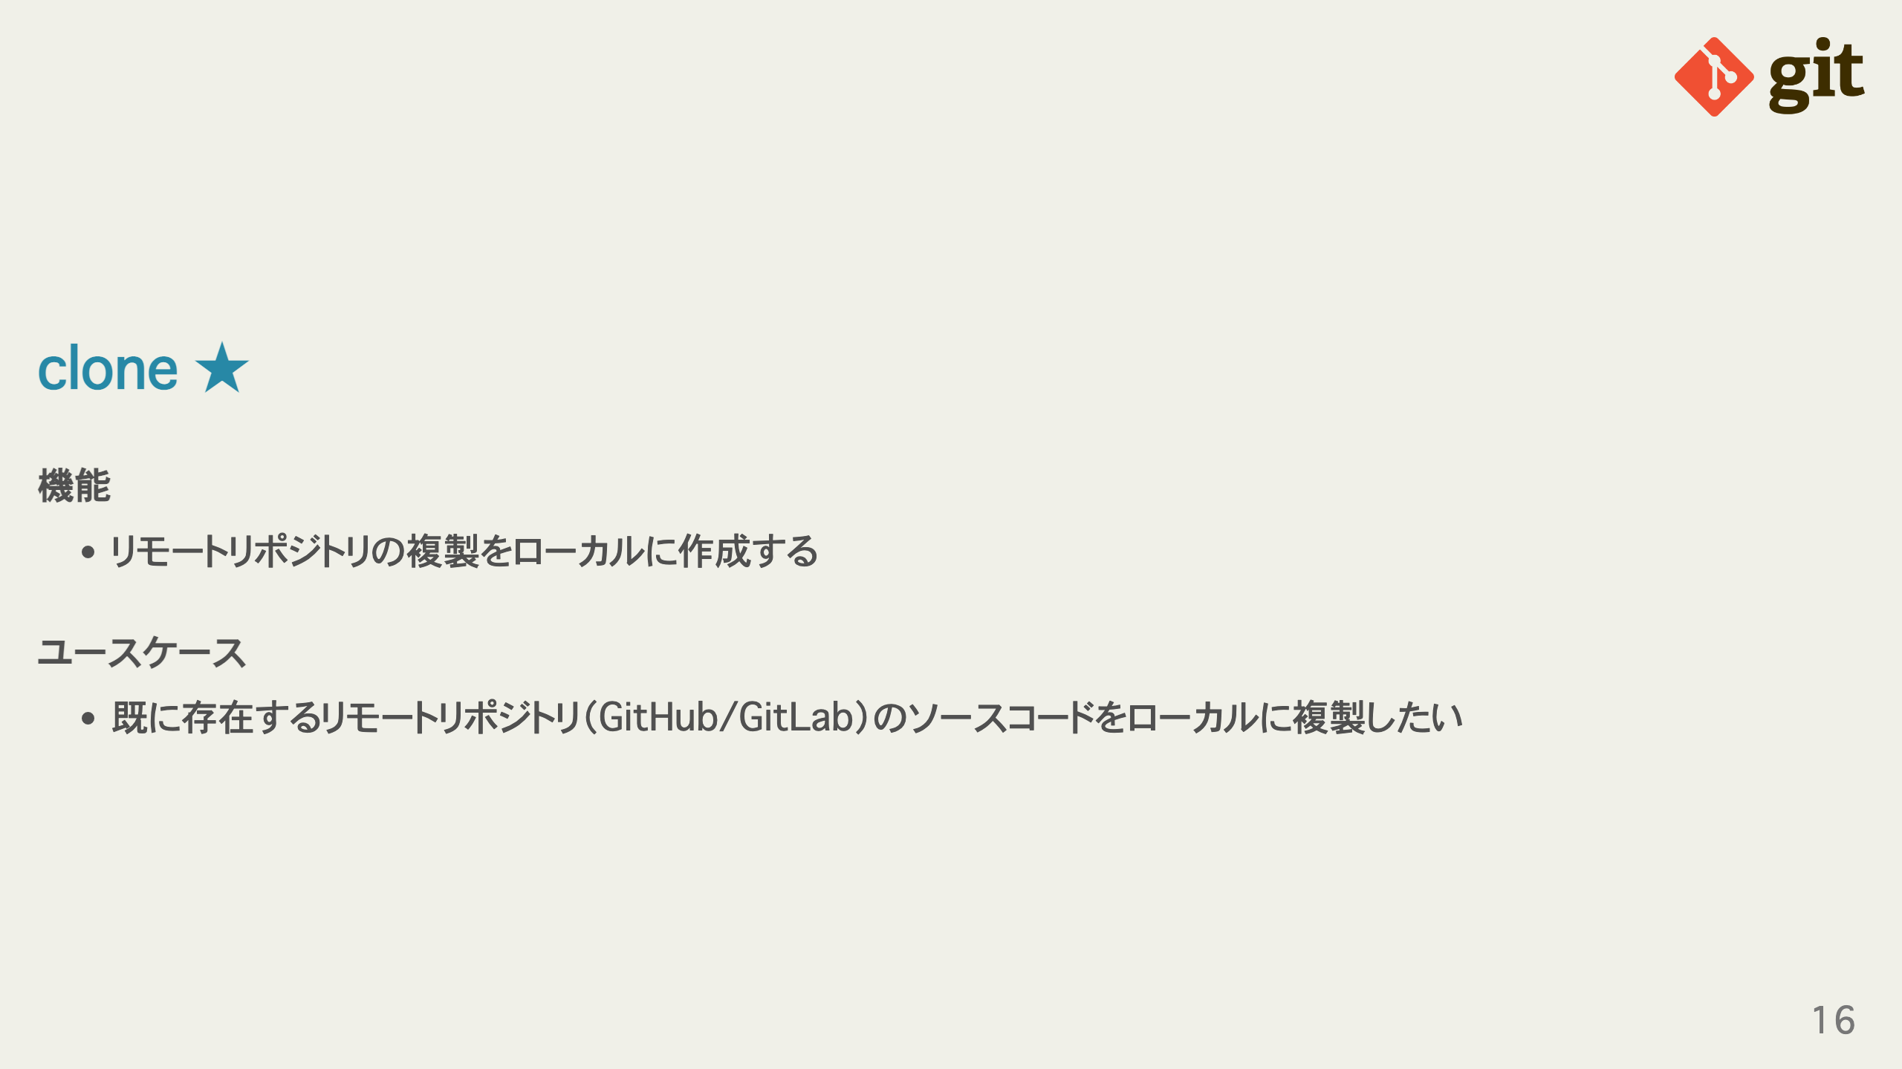
Notes:
omit in toc omit in toc

Slide 17
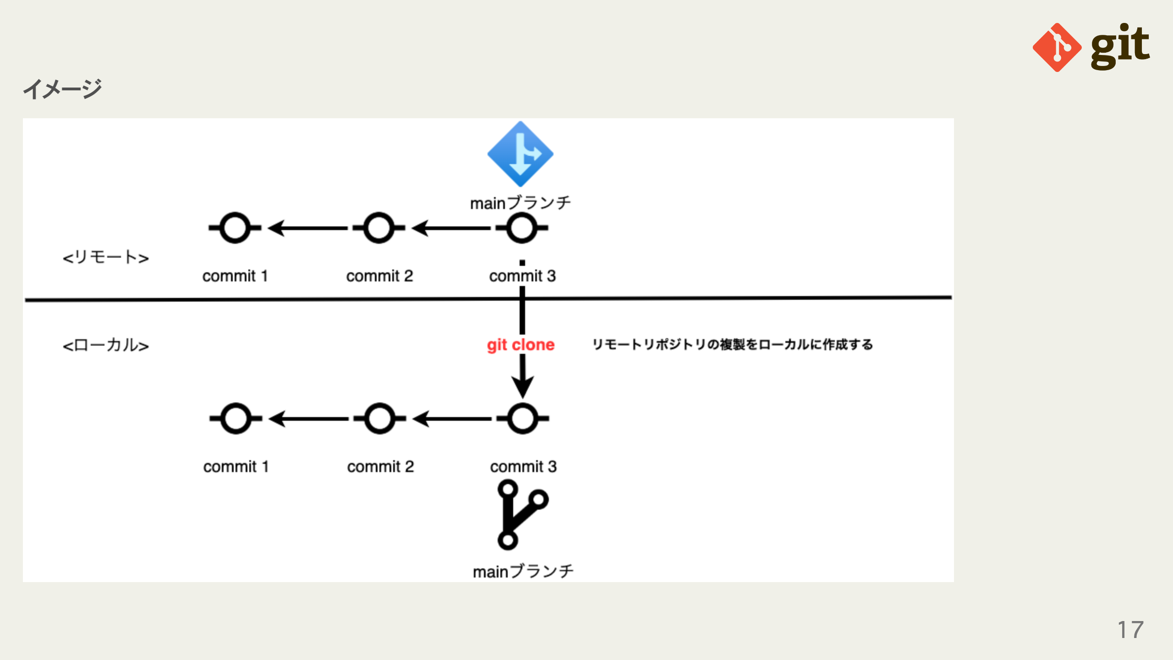
Notes:
omit in toc

Slide 18
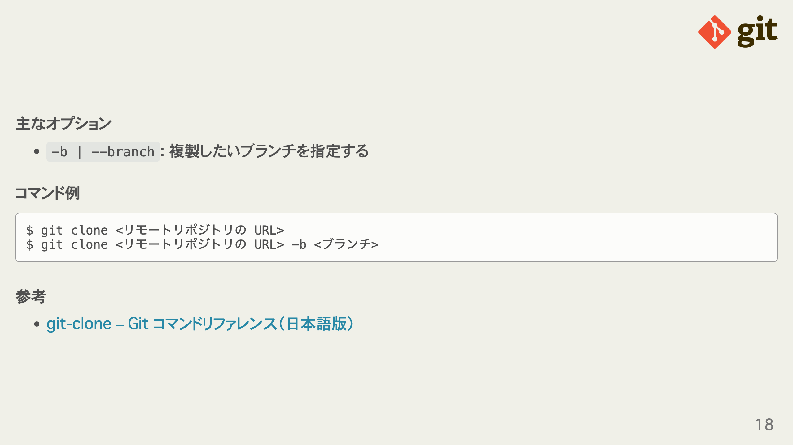
Notes:
omit in toc omit in toc omit in toc

Slide 19
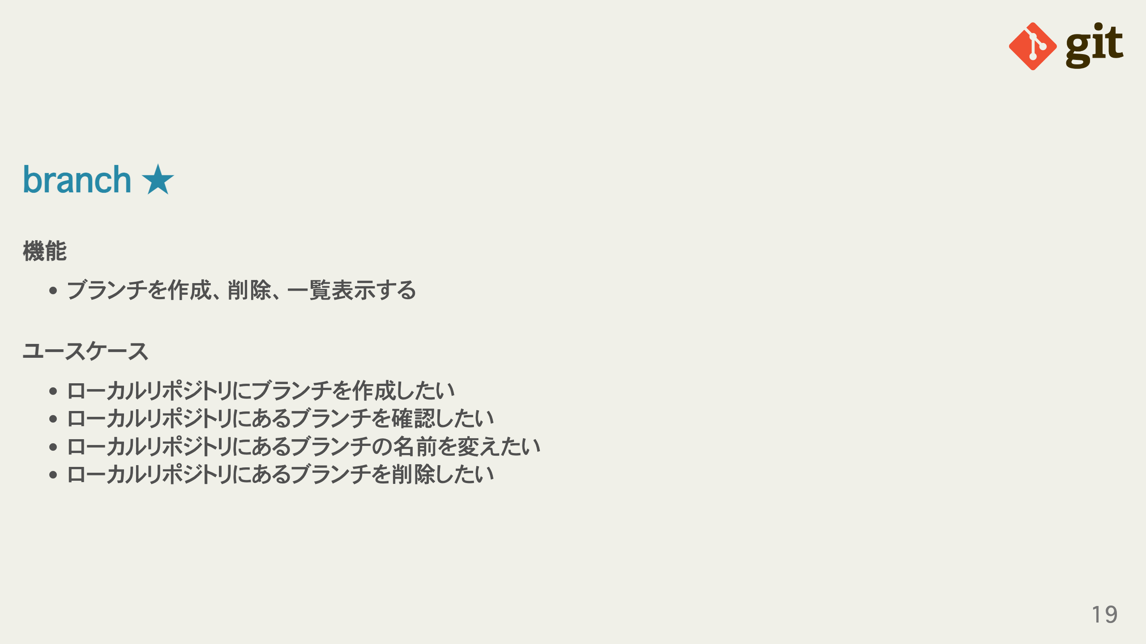
Notes:
omit in toc omit in toc

Slide 20
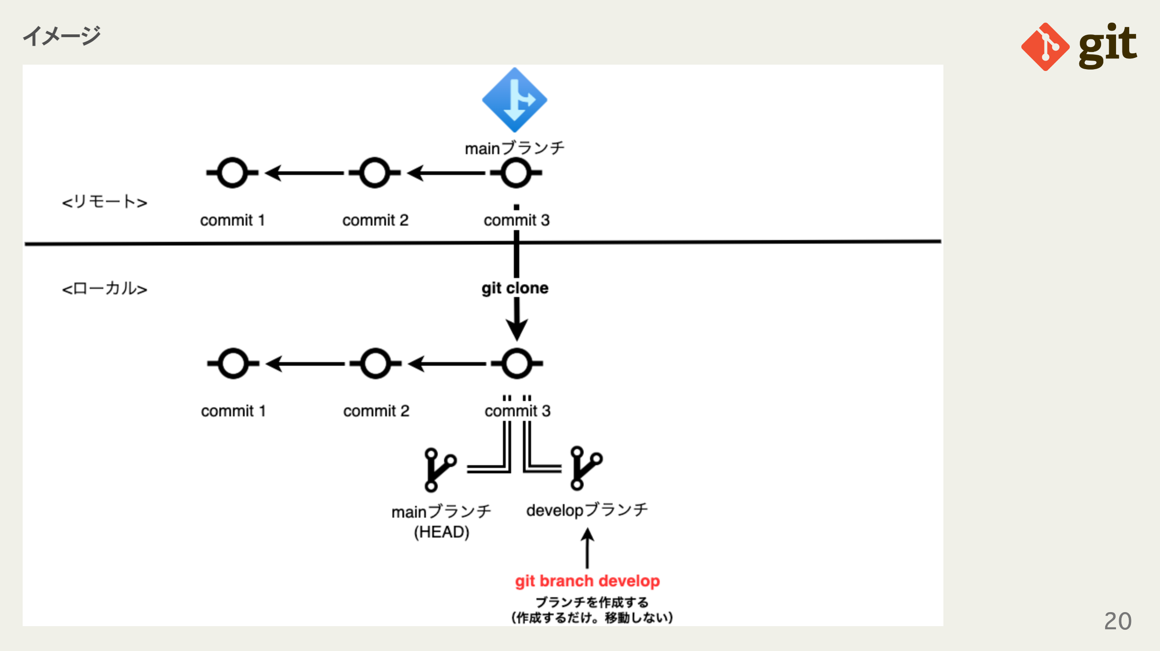
Notes:
omit in toc

Slide 21
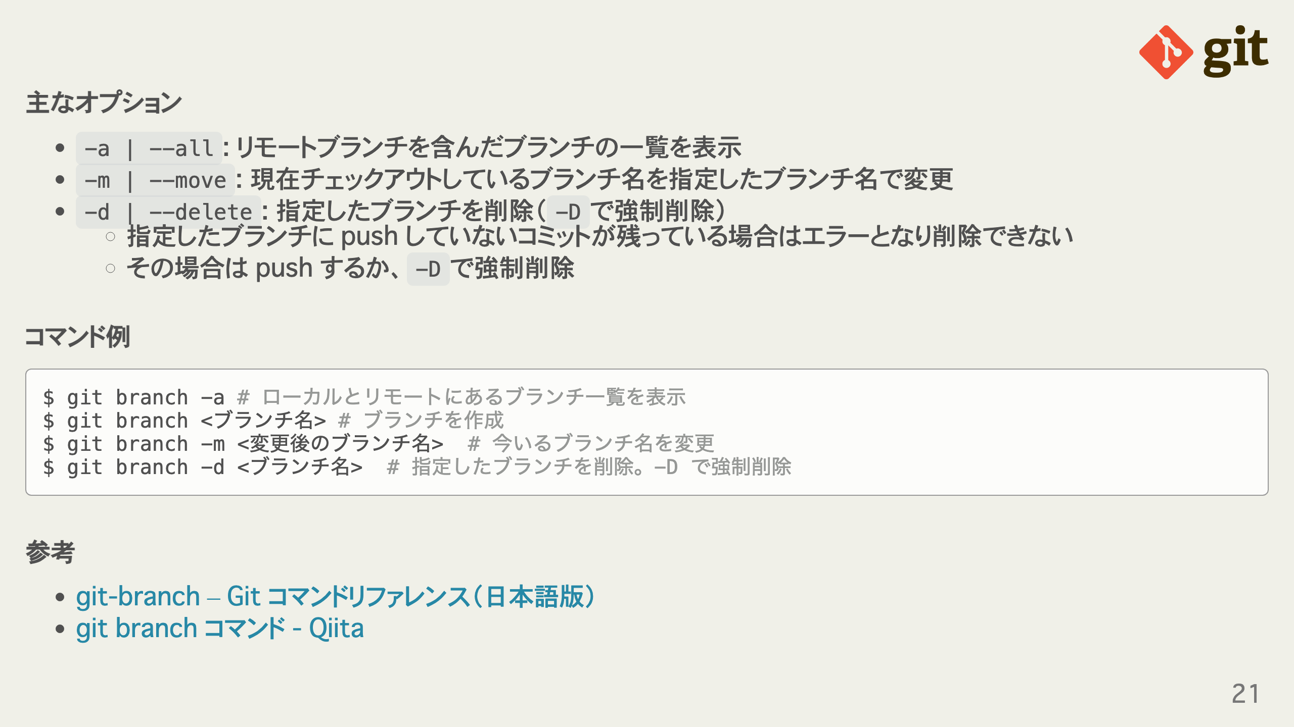
Notes:
omit in toc omit in toc omit in toc

Slide 22
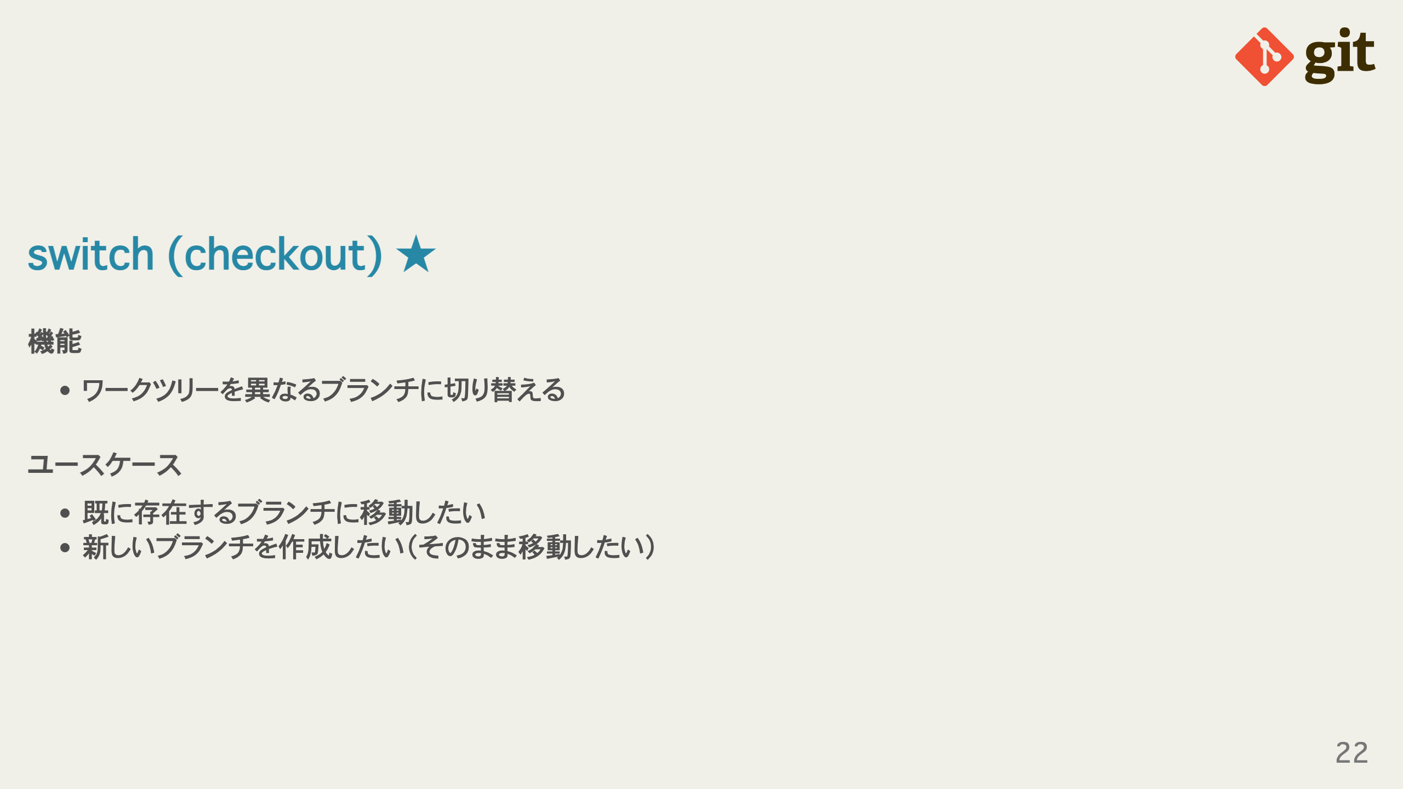
Notes:
omit in toc omit in toc

Slide 23
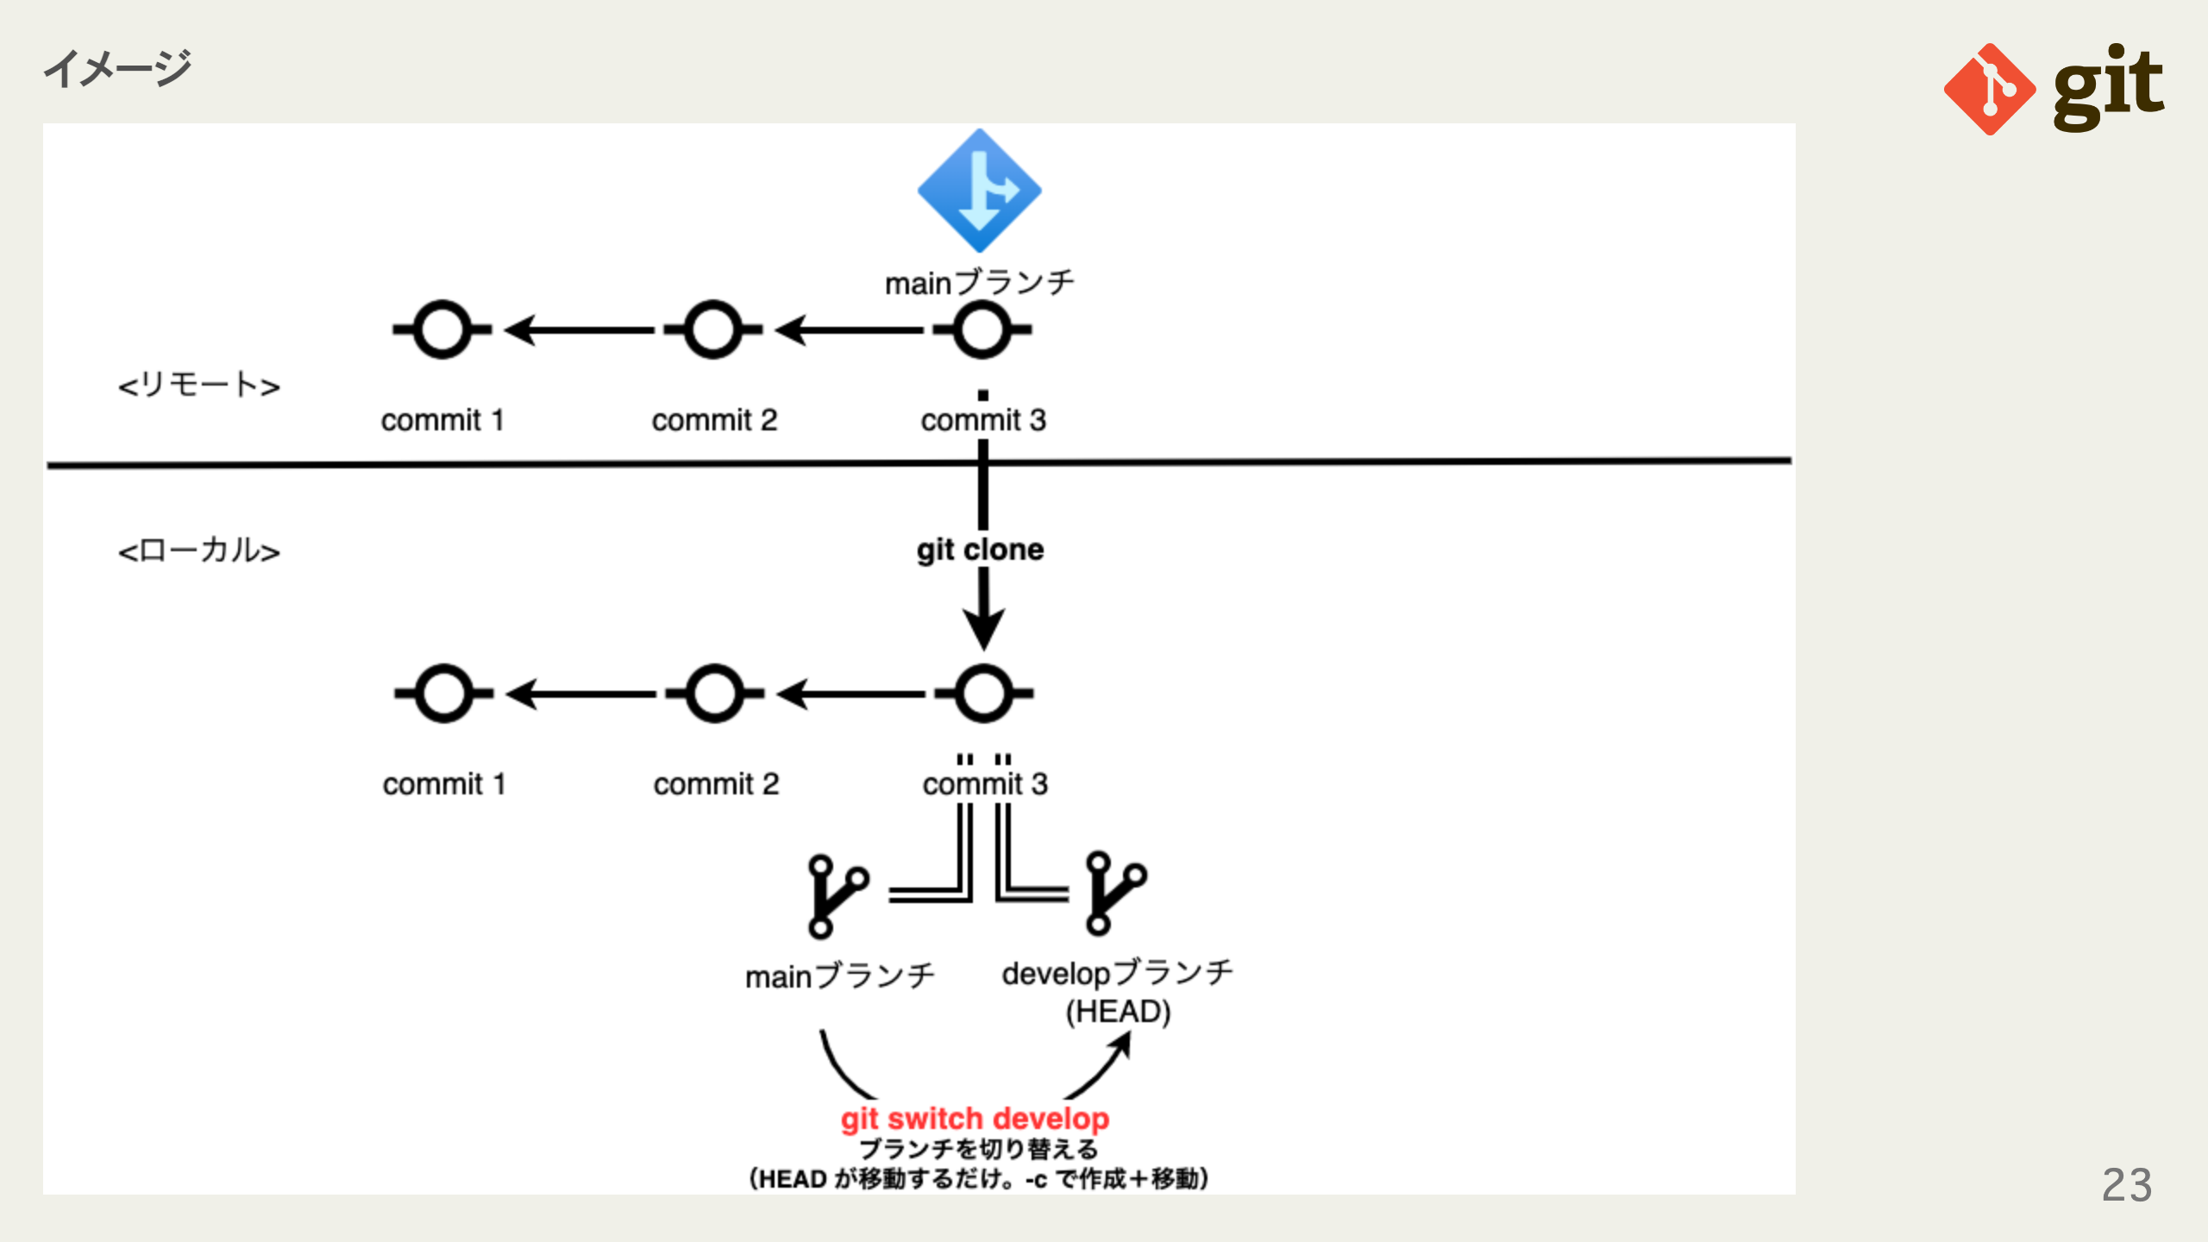
Notes:
omit in toc

Slide 24
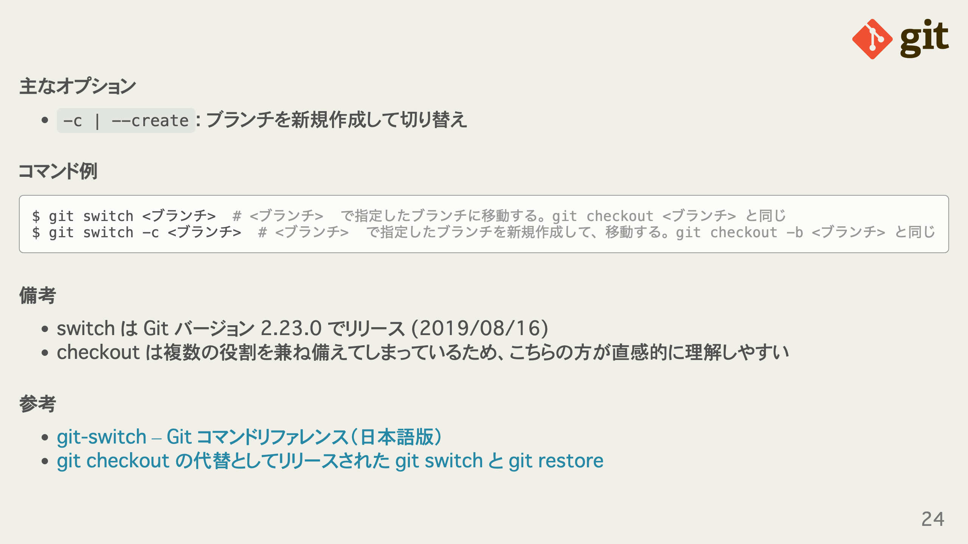
Notes:
omit in toc omit in toc omit in toc omit in toc

Slide 25
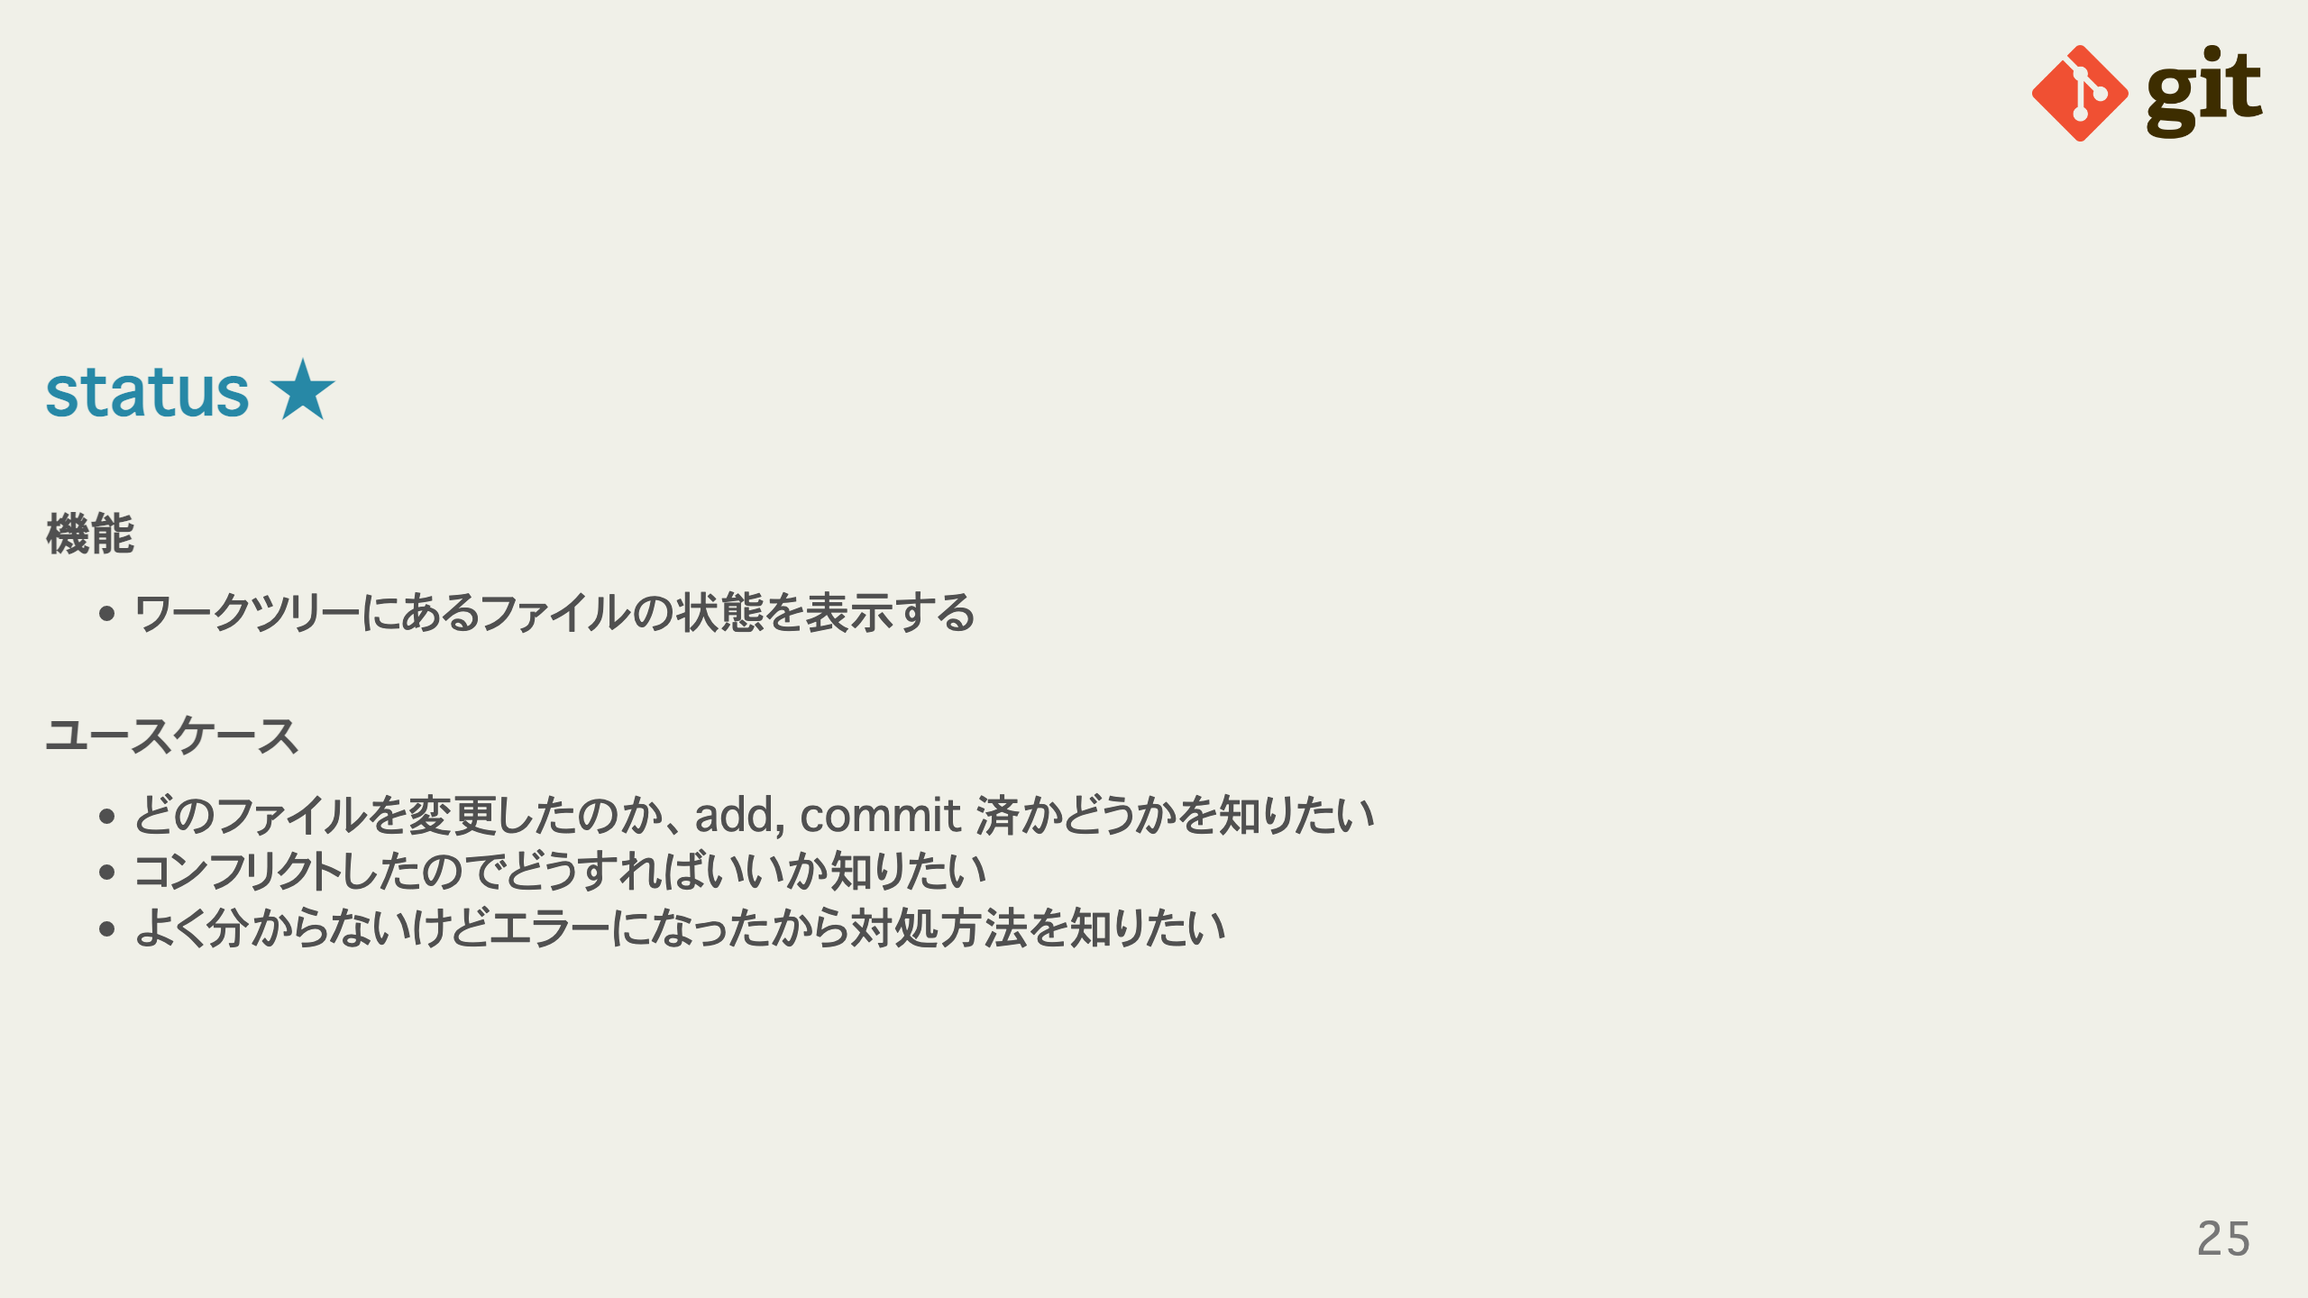
Notes:
omit in toc omit in toc

Slide 26
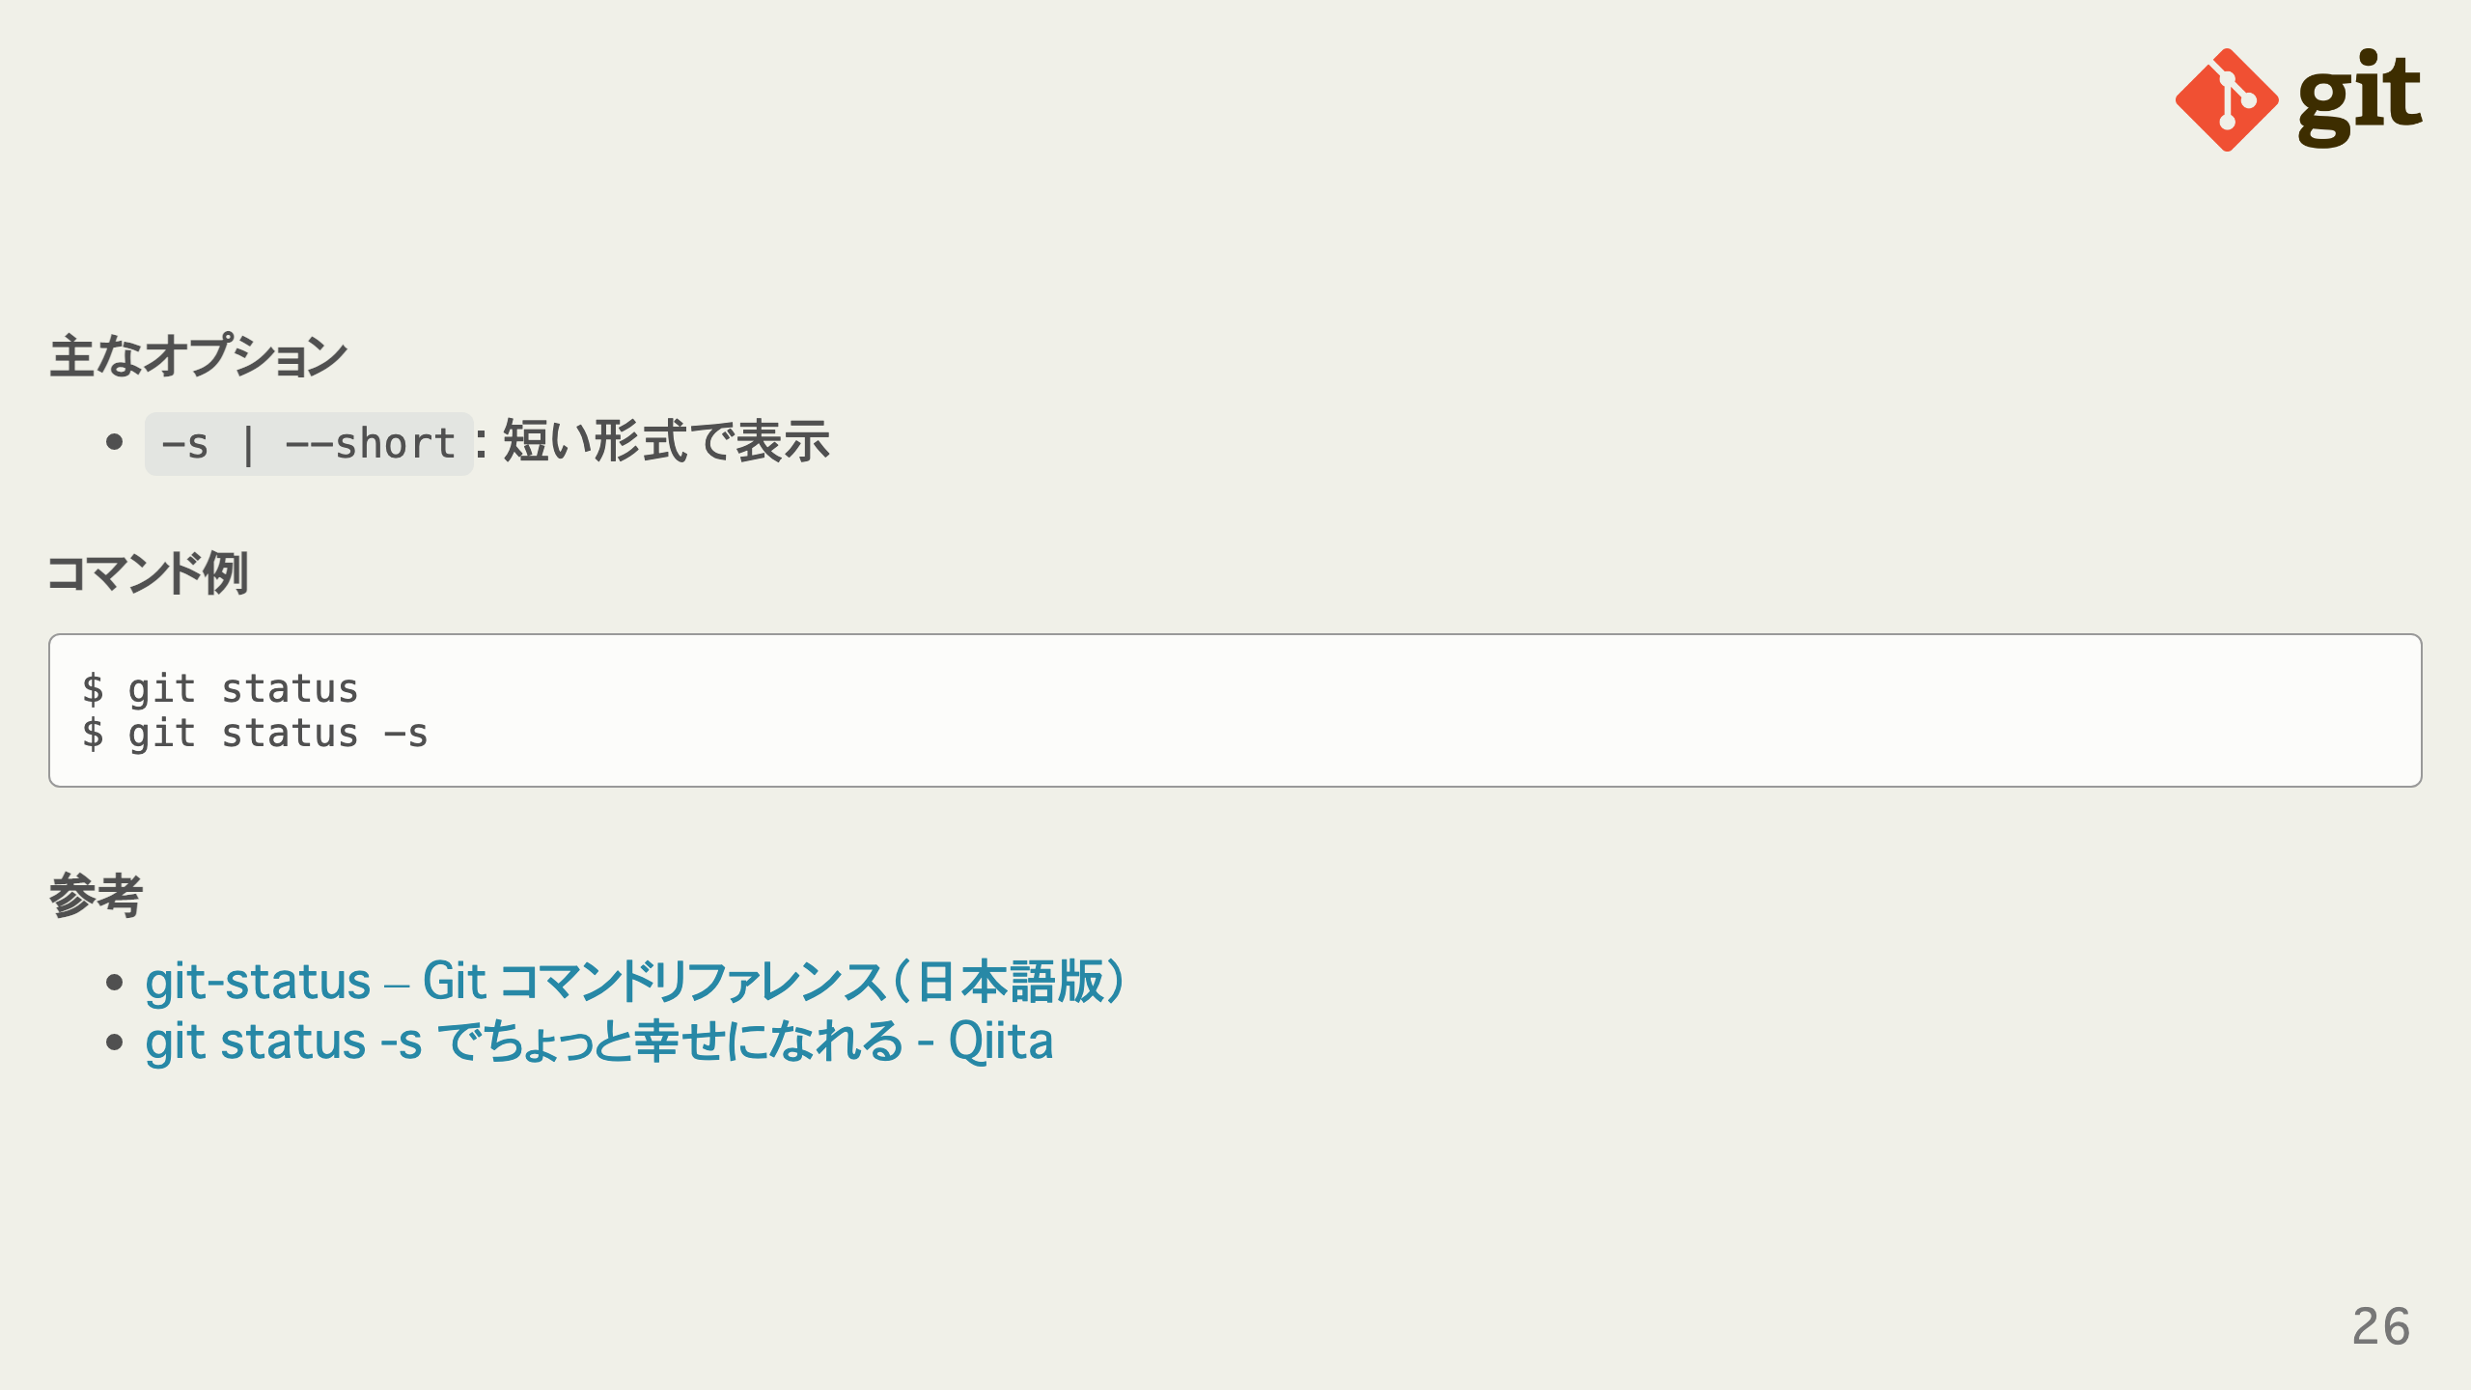
Notes:
omit in toc omit in toc omit in toc

Slide 27
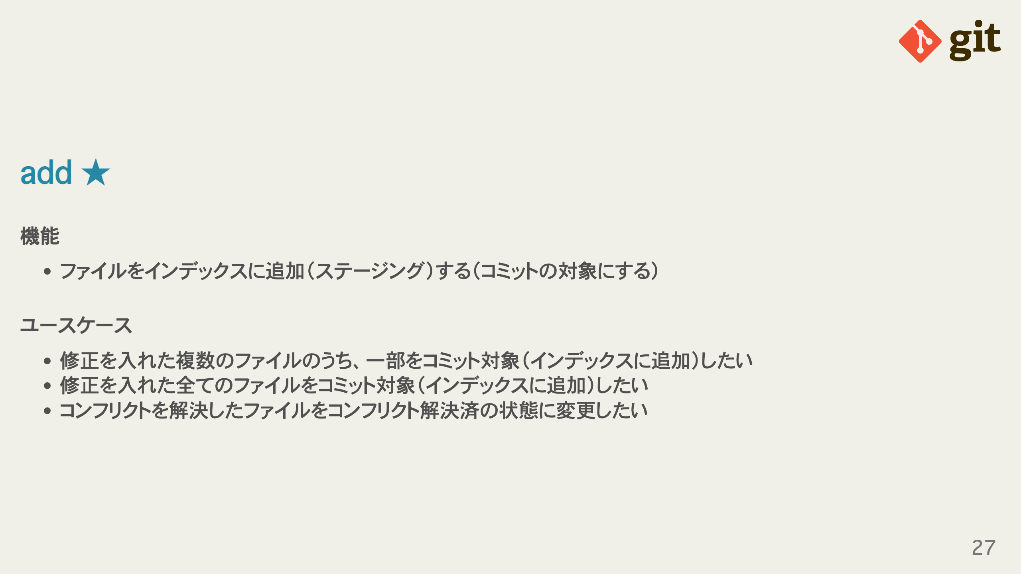
Notes:
omit in toc omit in toc

Slide 28
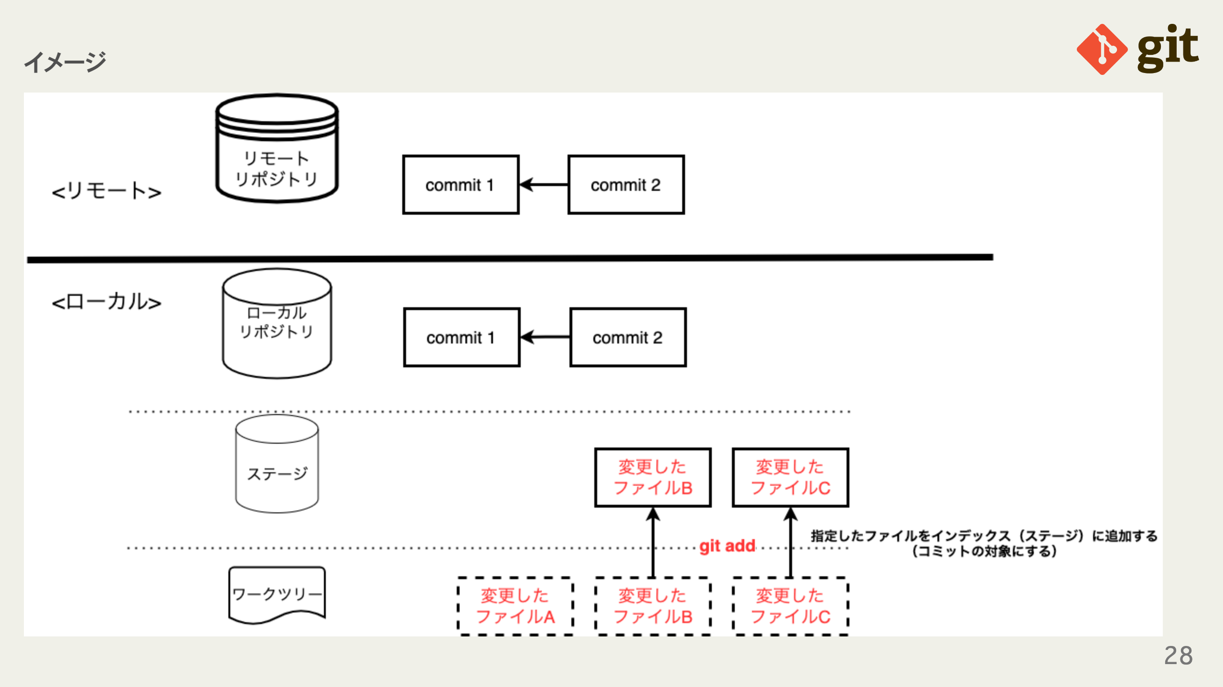
Notes:
omit in toc

Slide 29
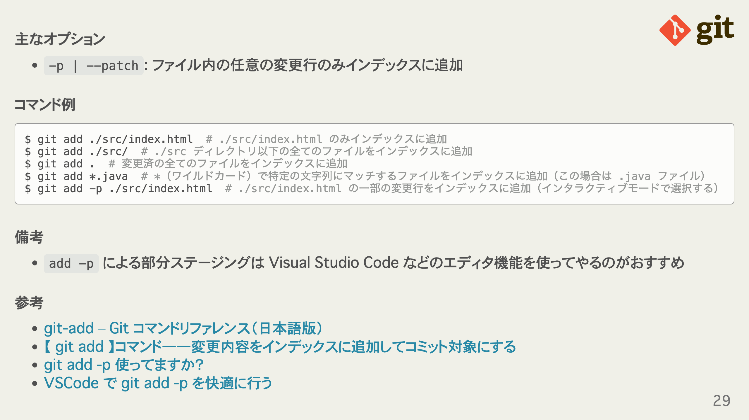
Notes:
omit in toc omit in toc omit in toc omit in toc

Slide 30
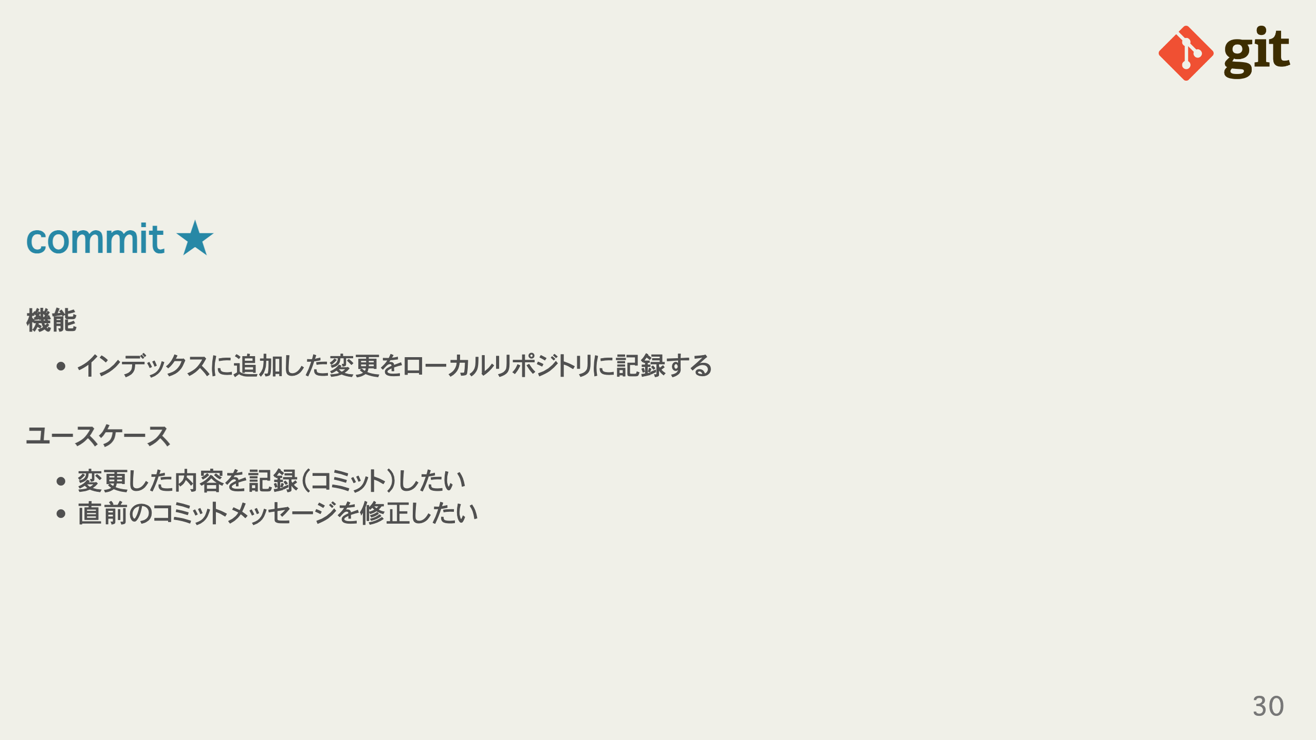
Notes:
omit in toc omit in toc

Slide 31
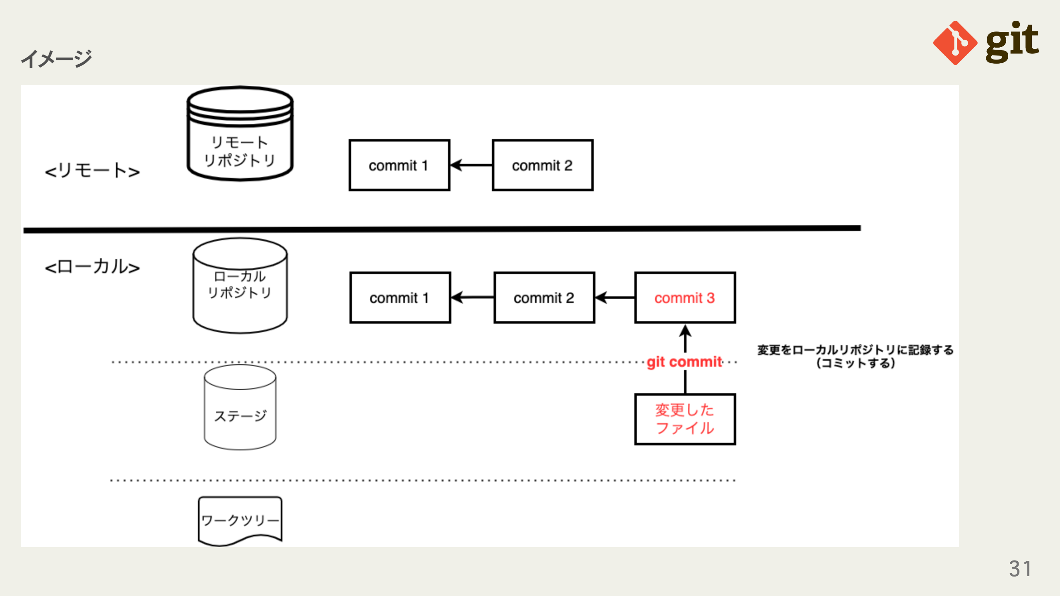
Notes:
omit in toc

Slide 32
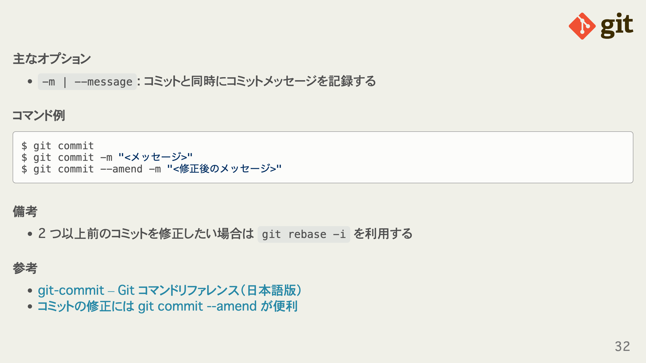
Notes:
omit in toc omit in toc omit in toc omit in toc

Slide 33
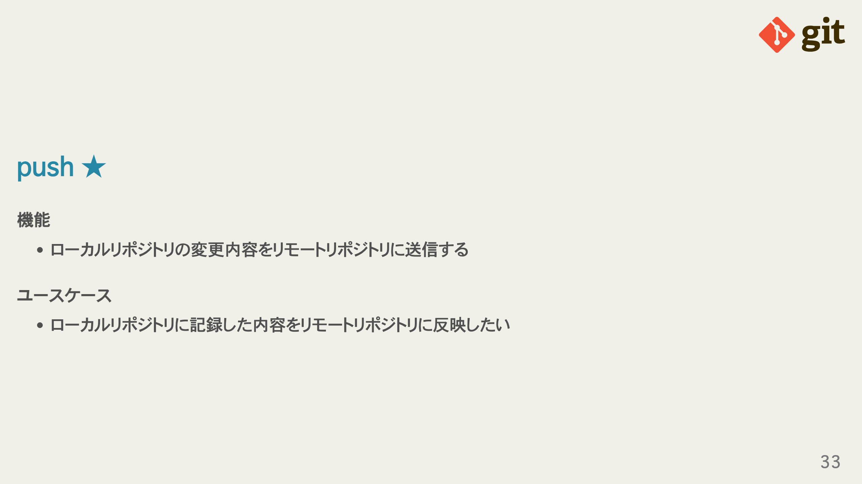
Notes:
omit in toc omit in toc

Slide 34
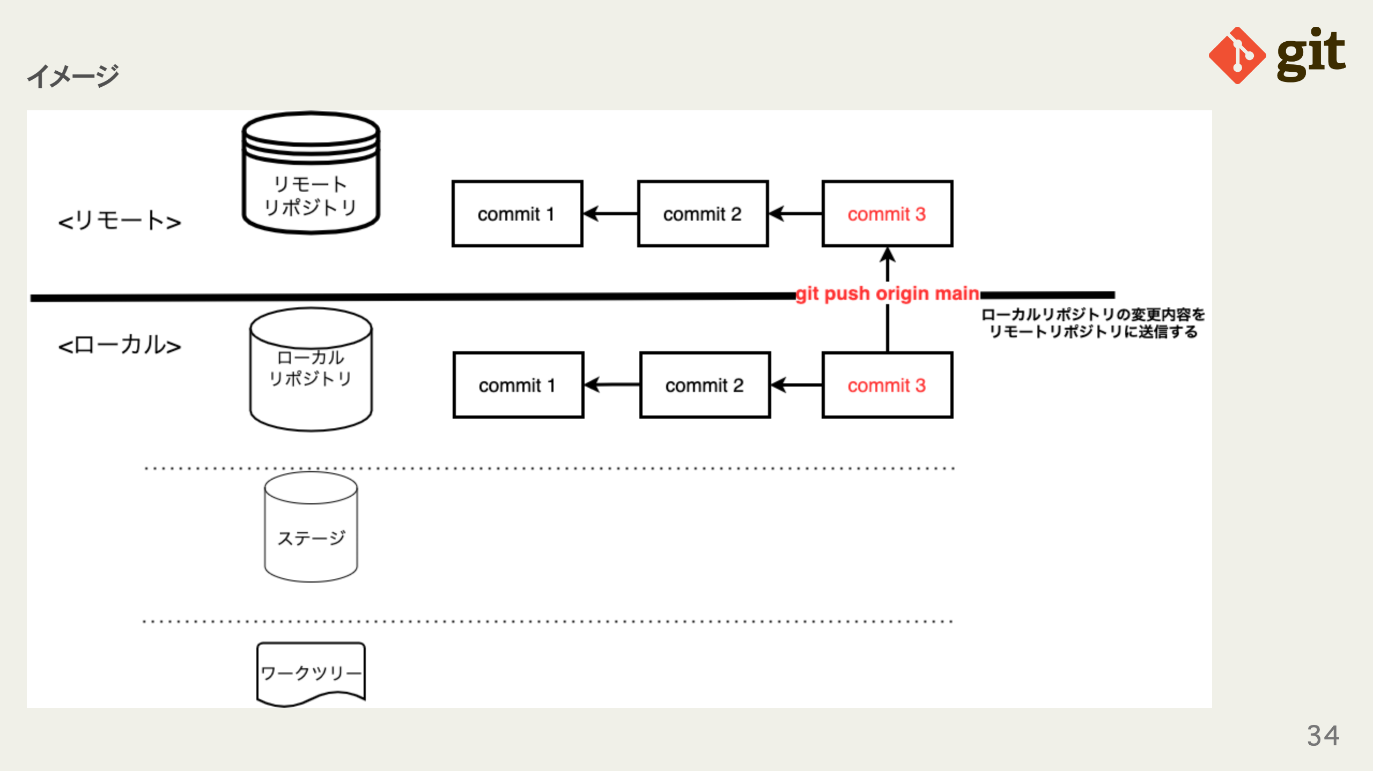
Notes:
omit in toc

Slide 35
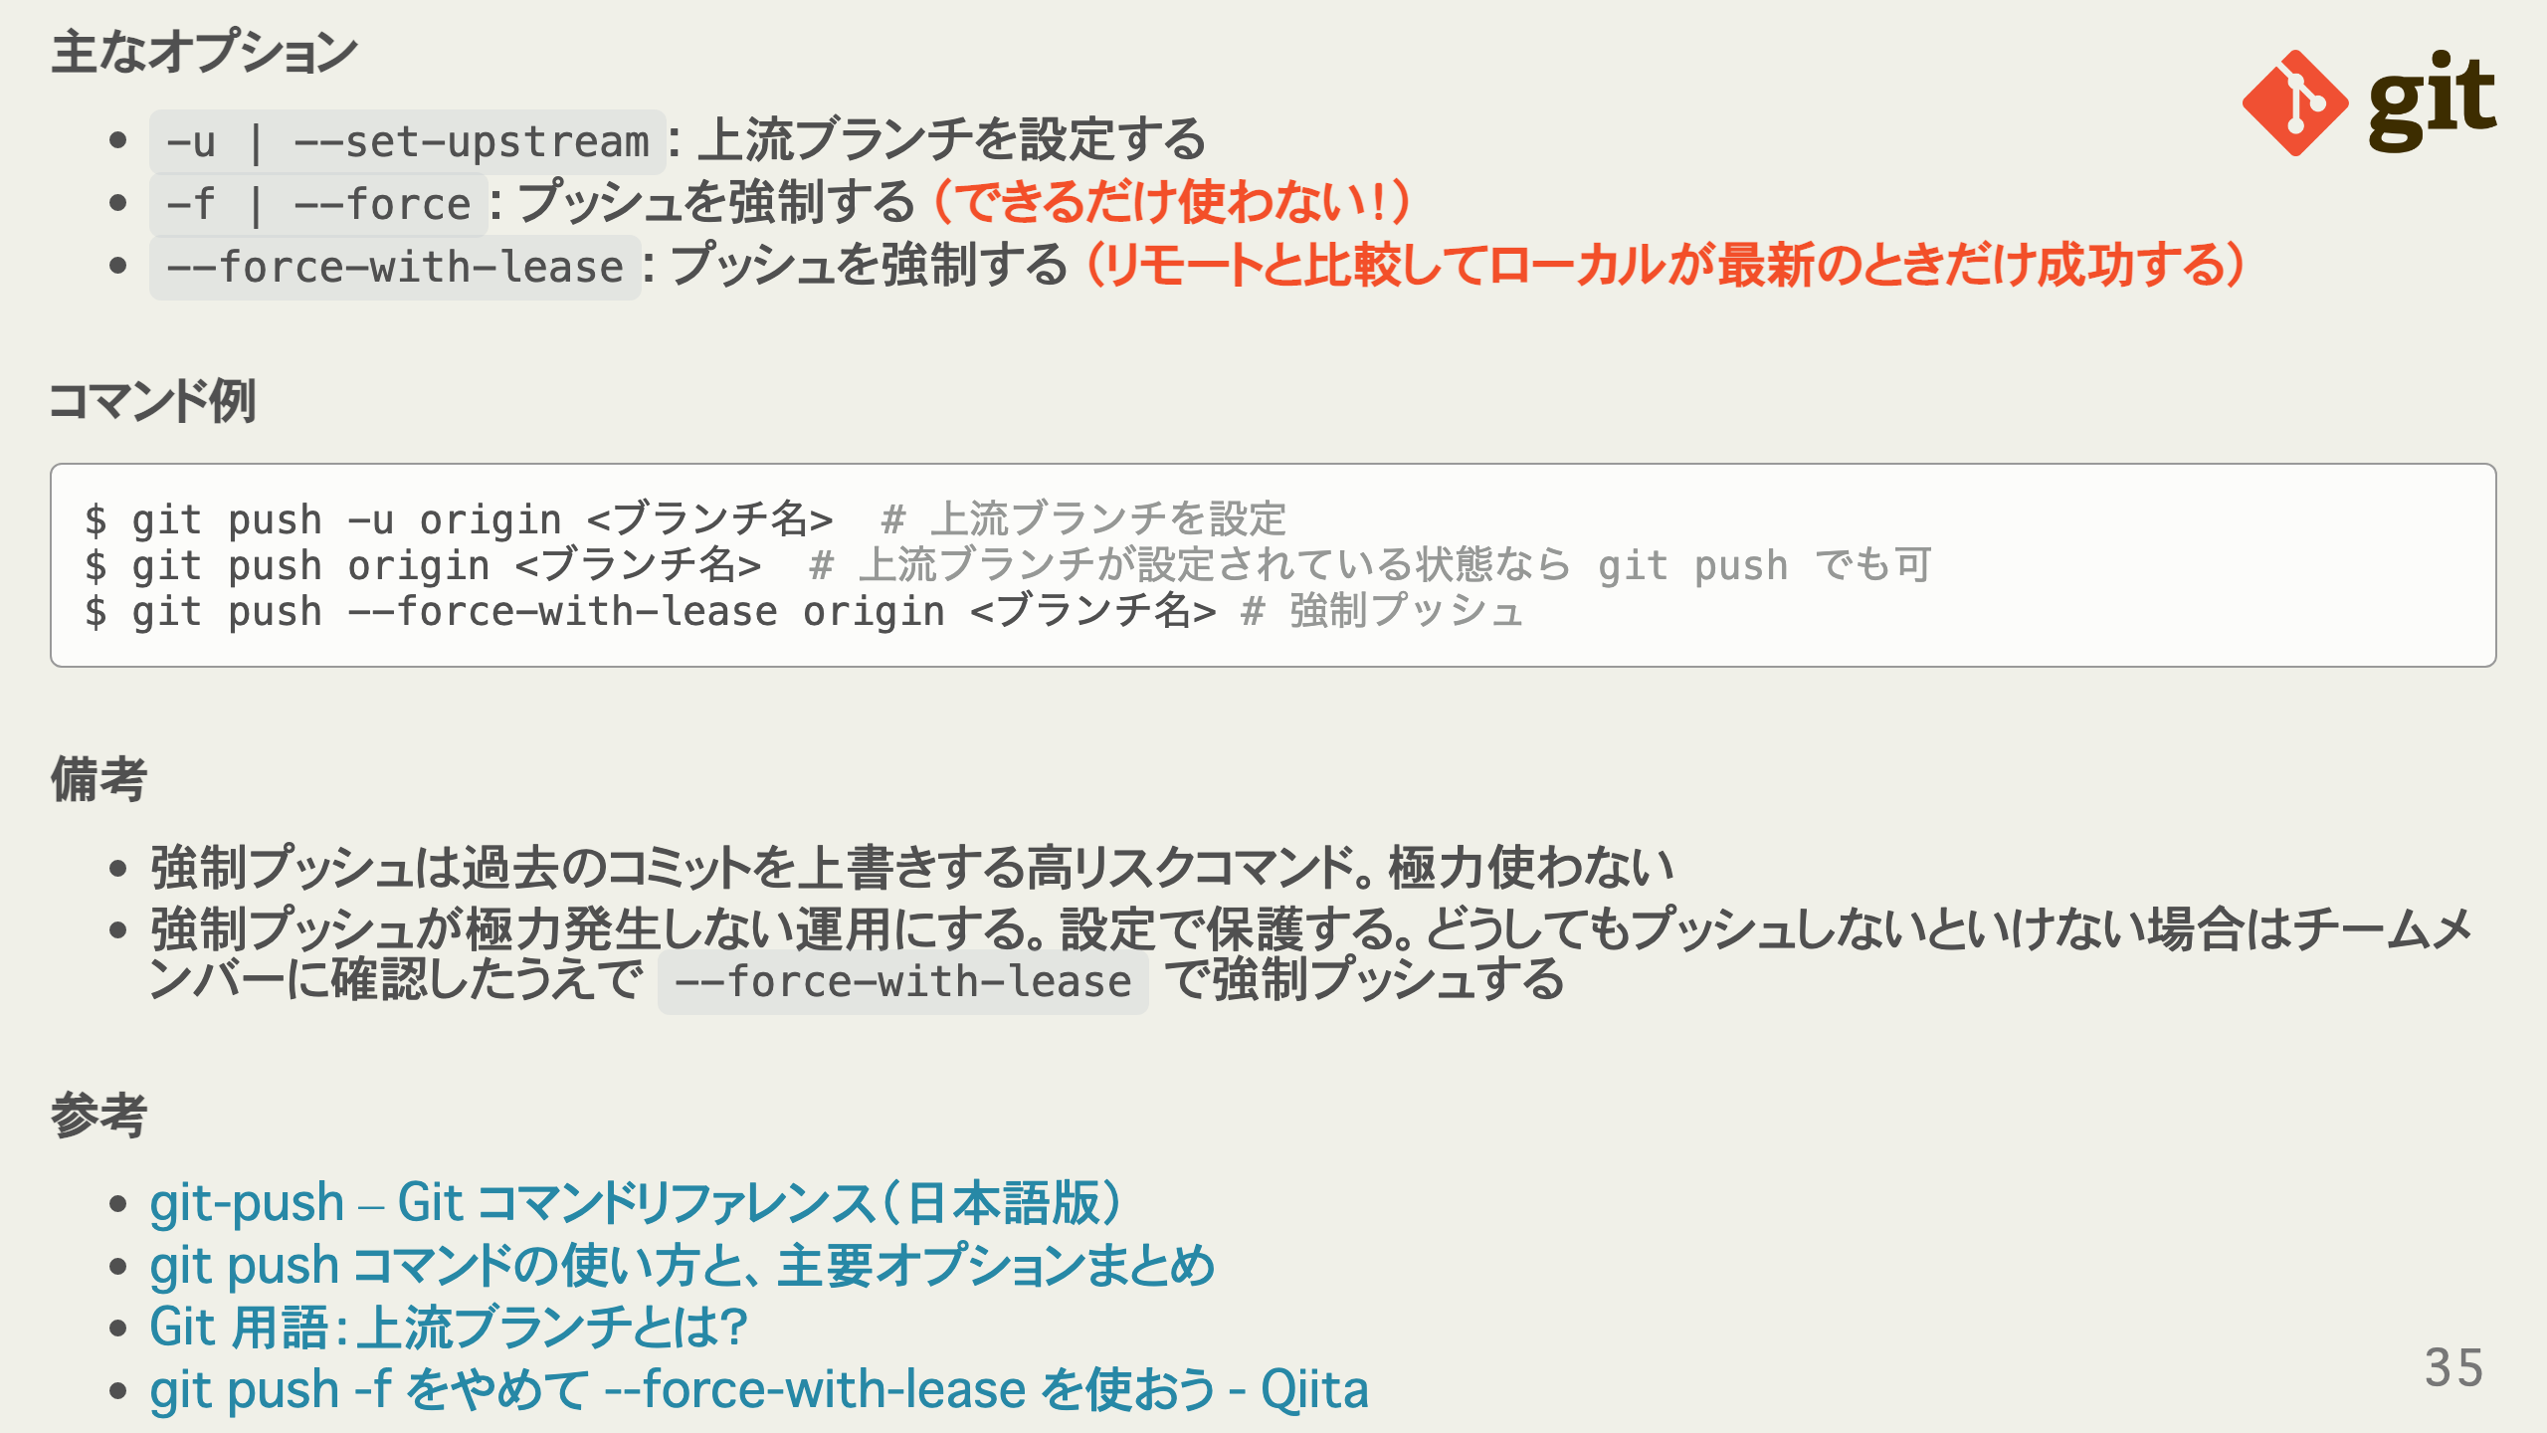
Notes:
omit in toc omit in toc omit in toc omit in toc

Slide 36
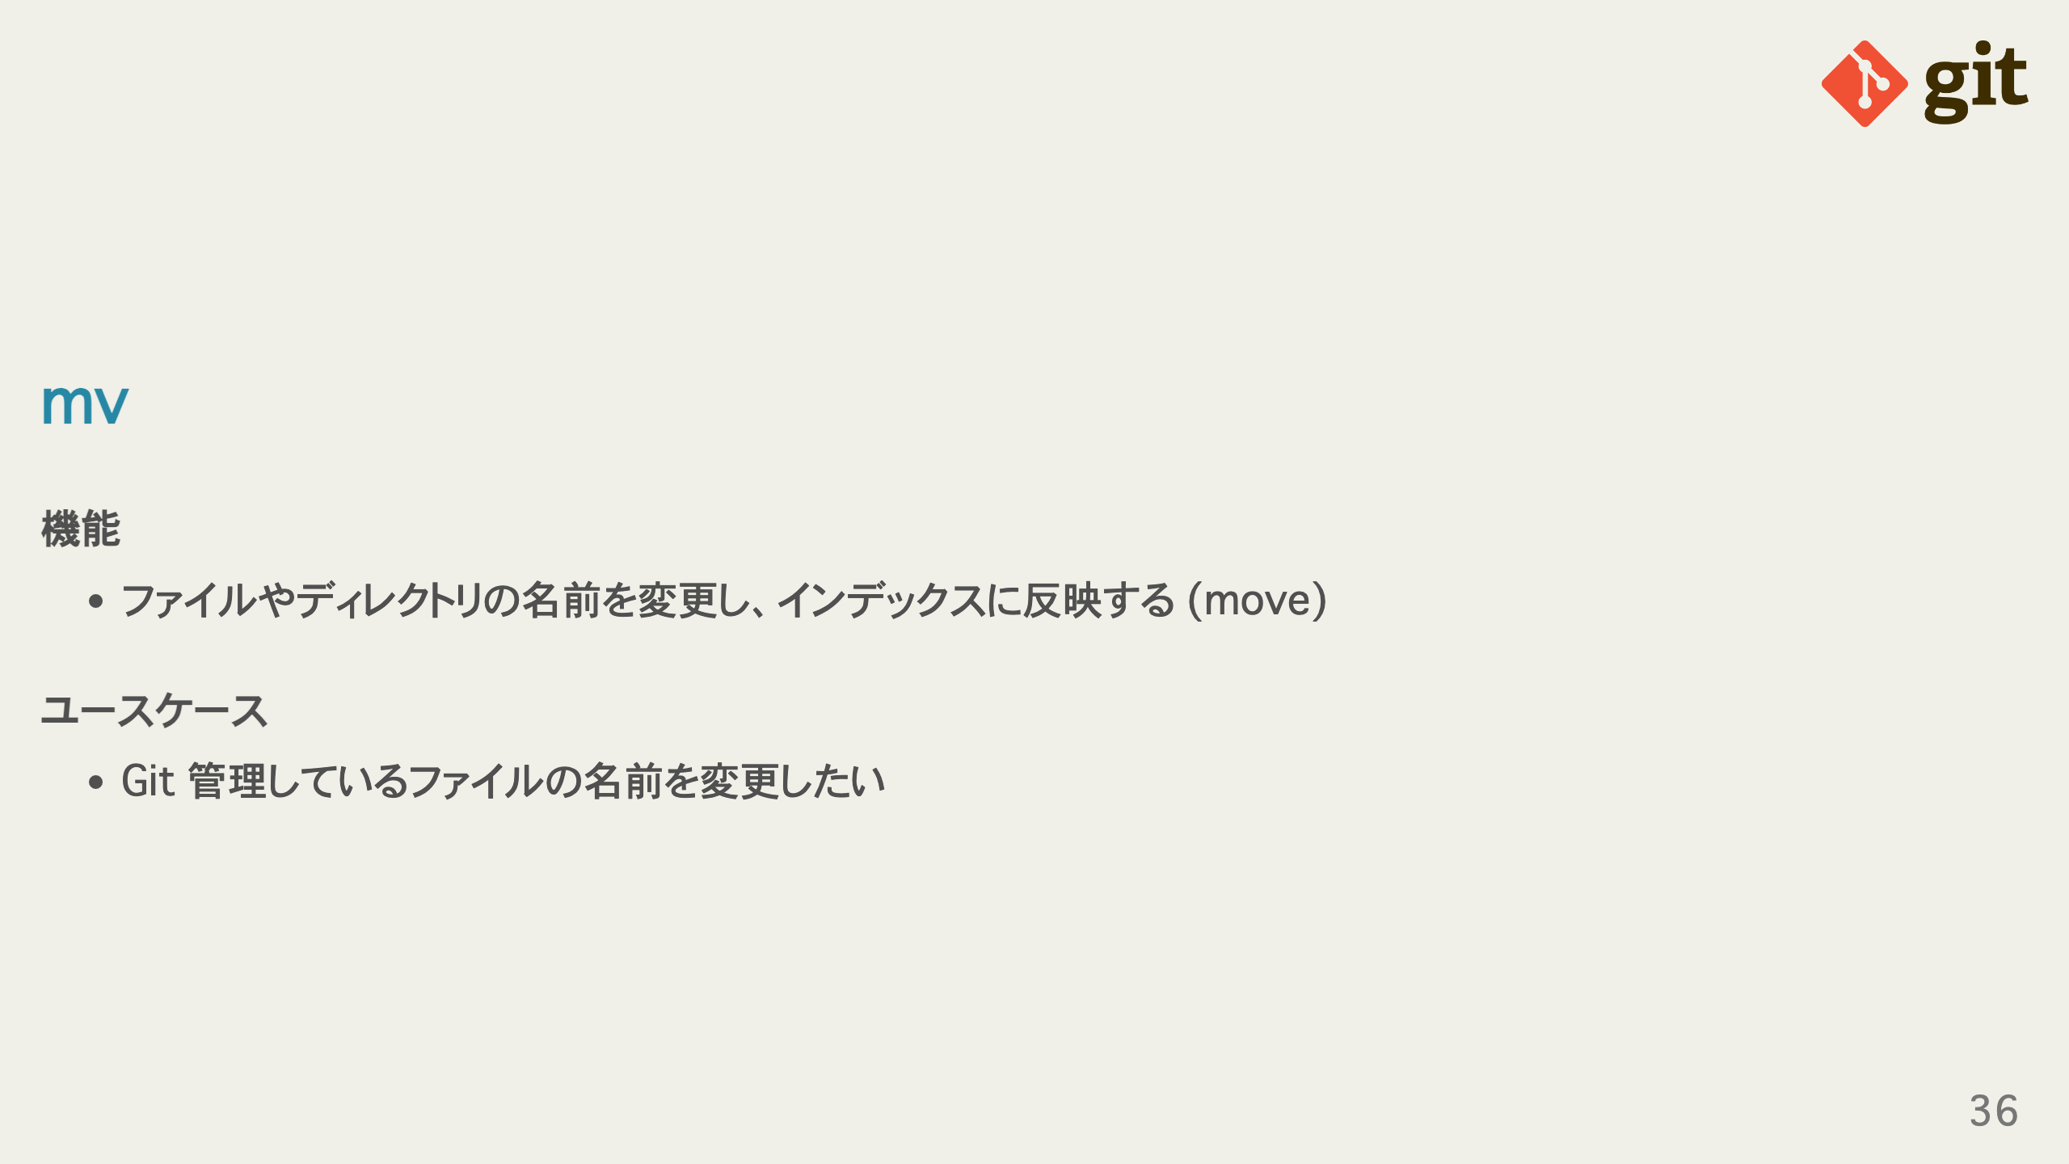
Notes:
omit in toc omit in toc

Slide 37
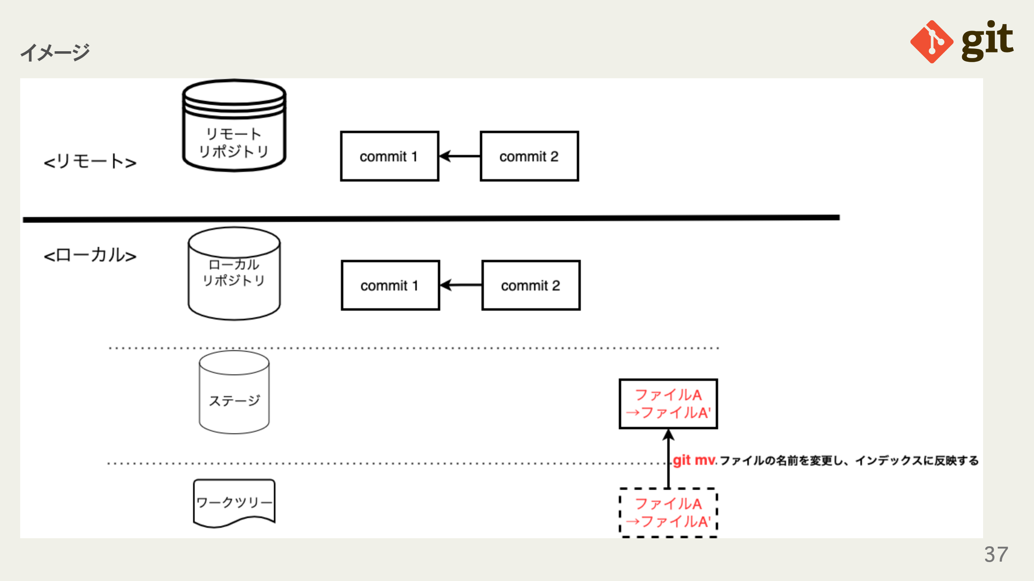
Notes:
omit in toc

Slide 38
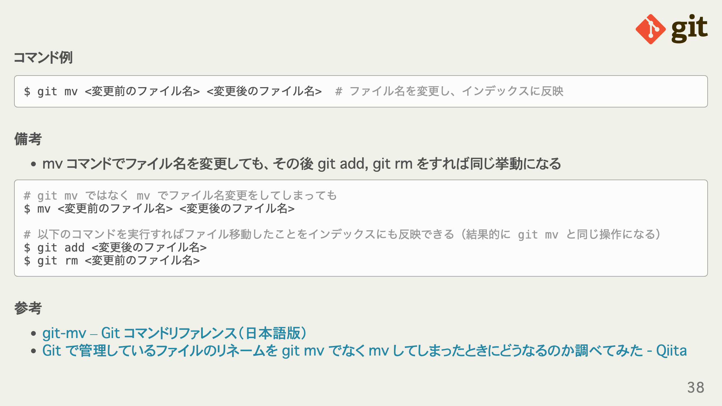
Notes:
omit in toc omit in toc omit in toc

Slide 39
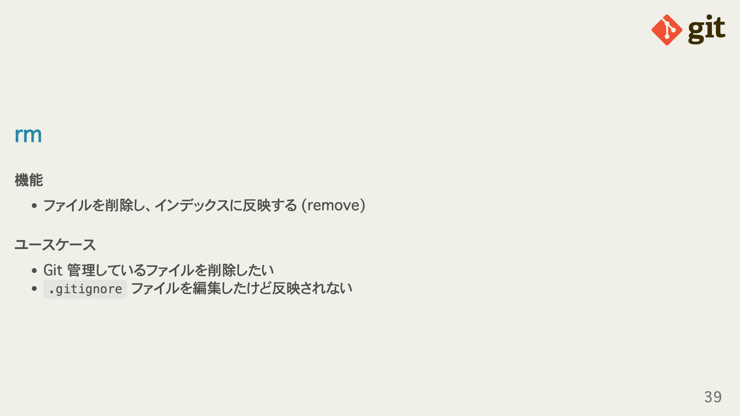
Notes:
omit in toc omit in toc

Slide 40
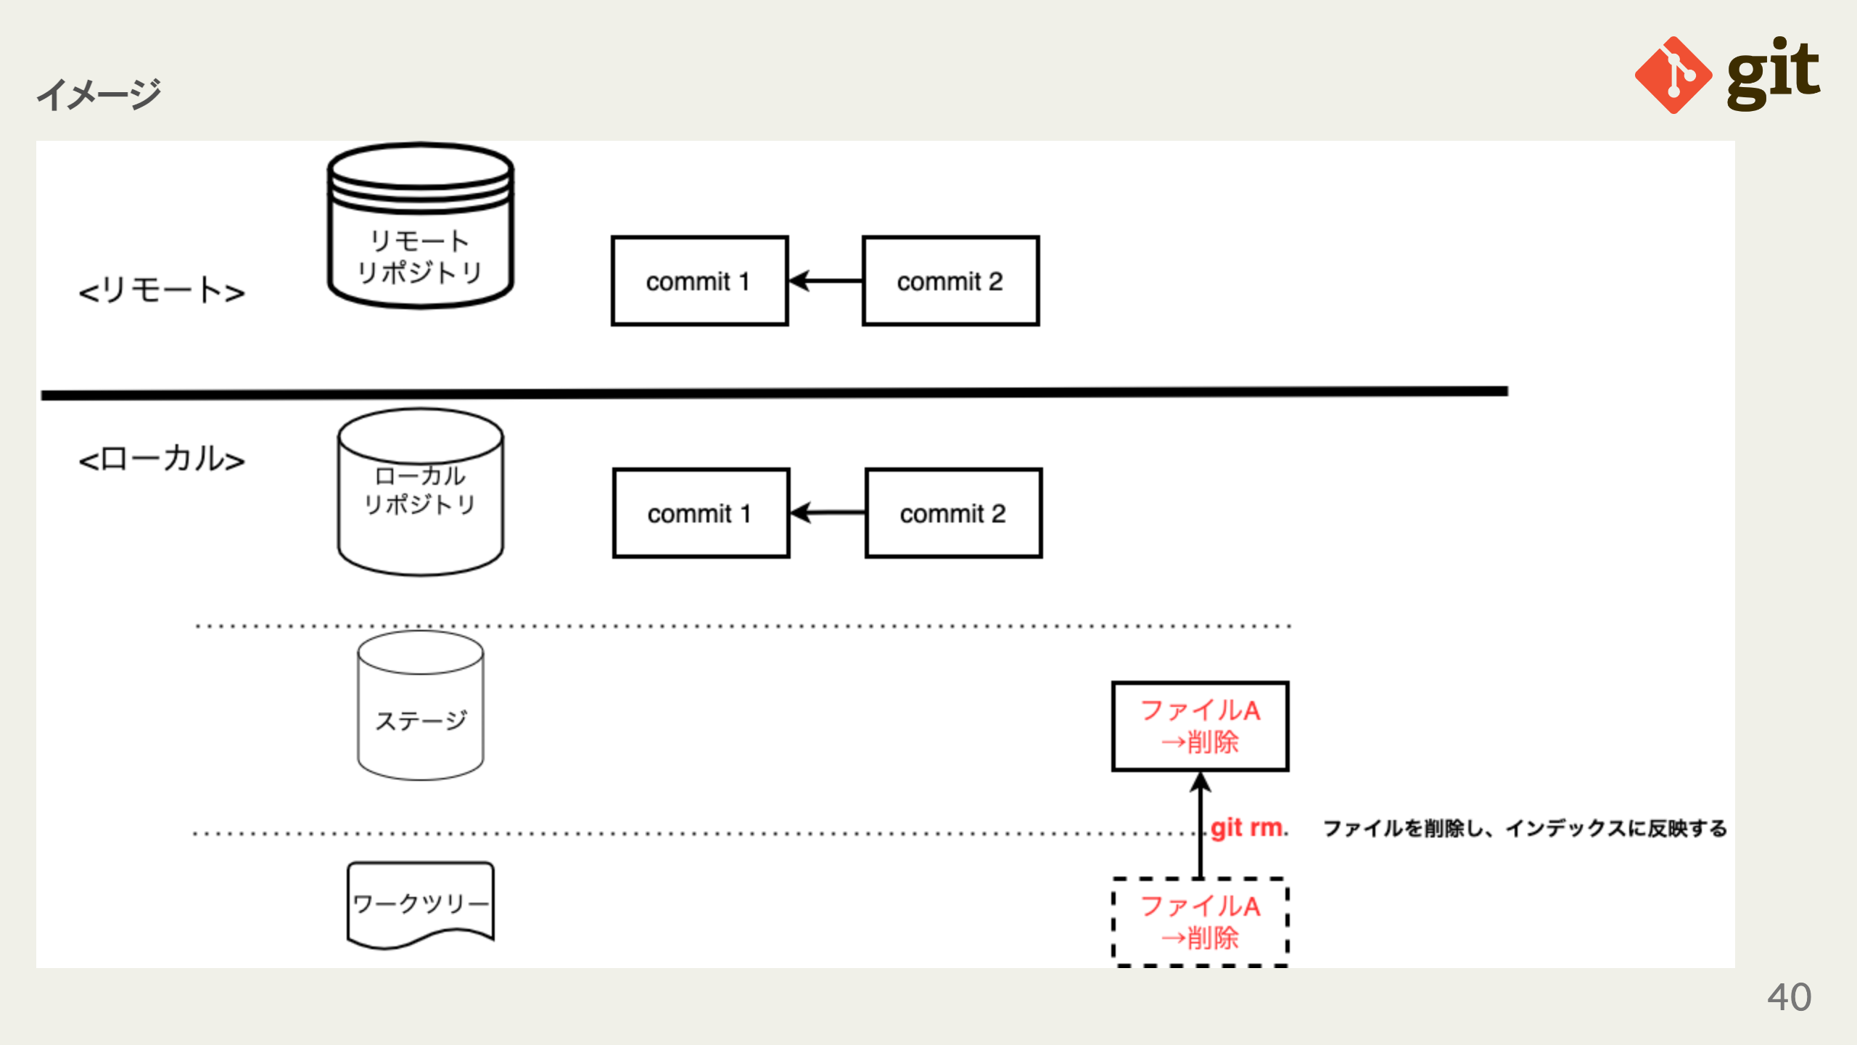
Notes:
omit in toc

Slide 41
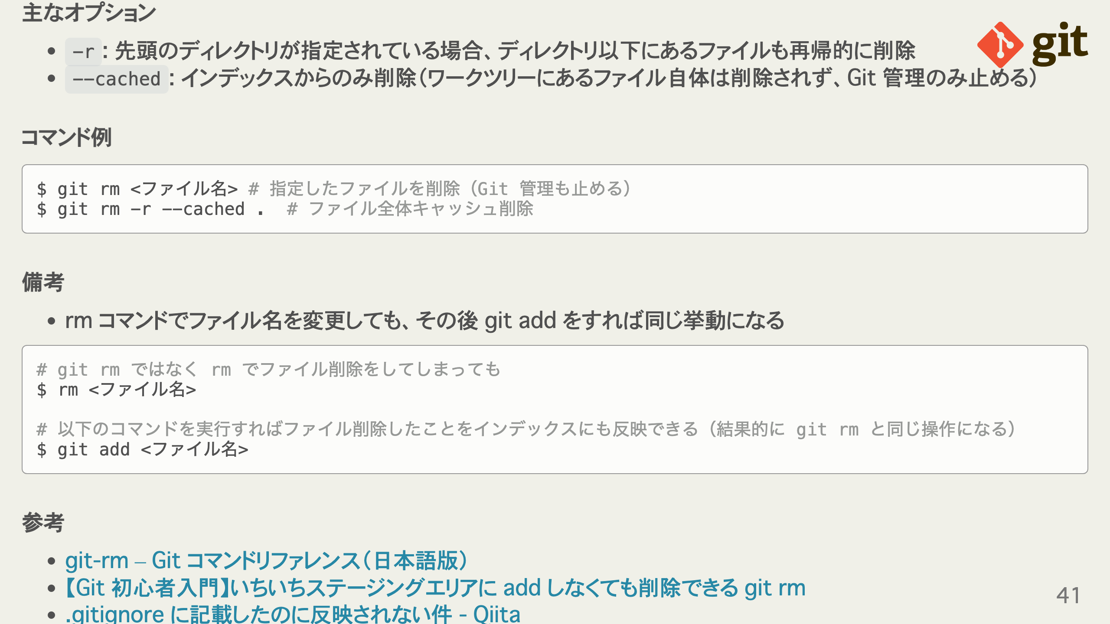
Notes:
omit in toc omit in toc omit in toc omit in toc

Slide 42
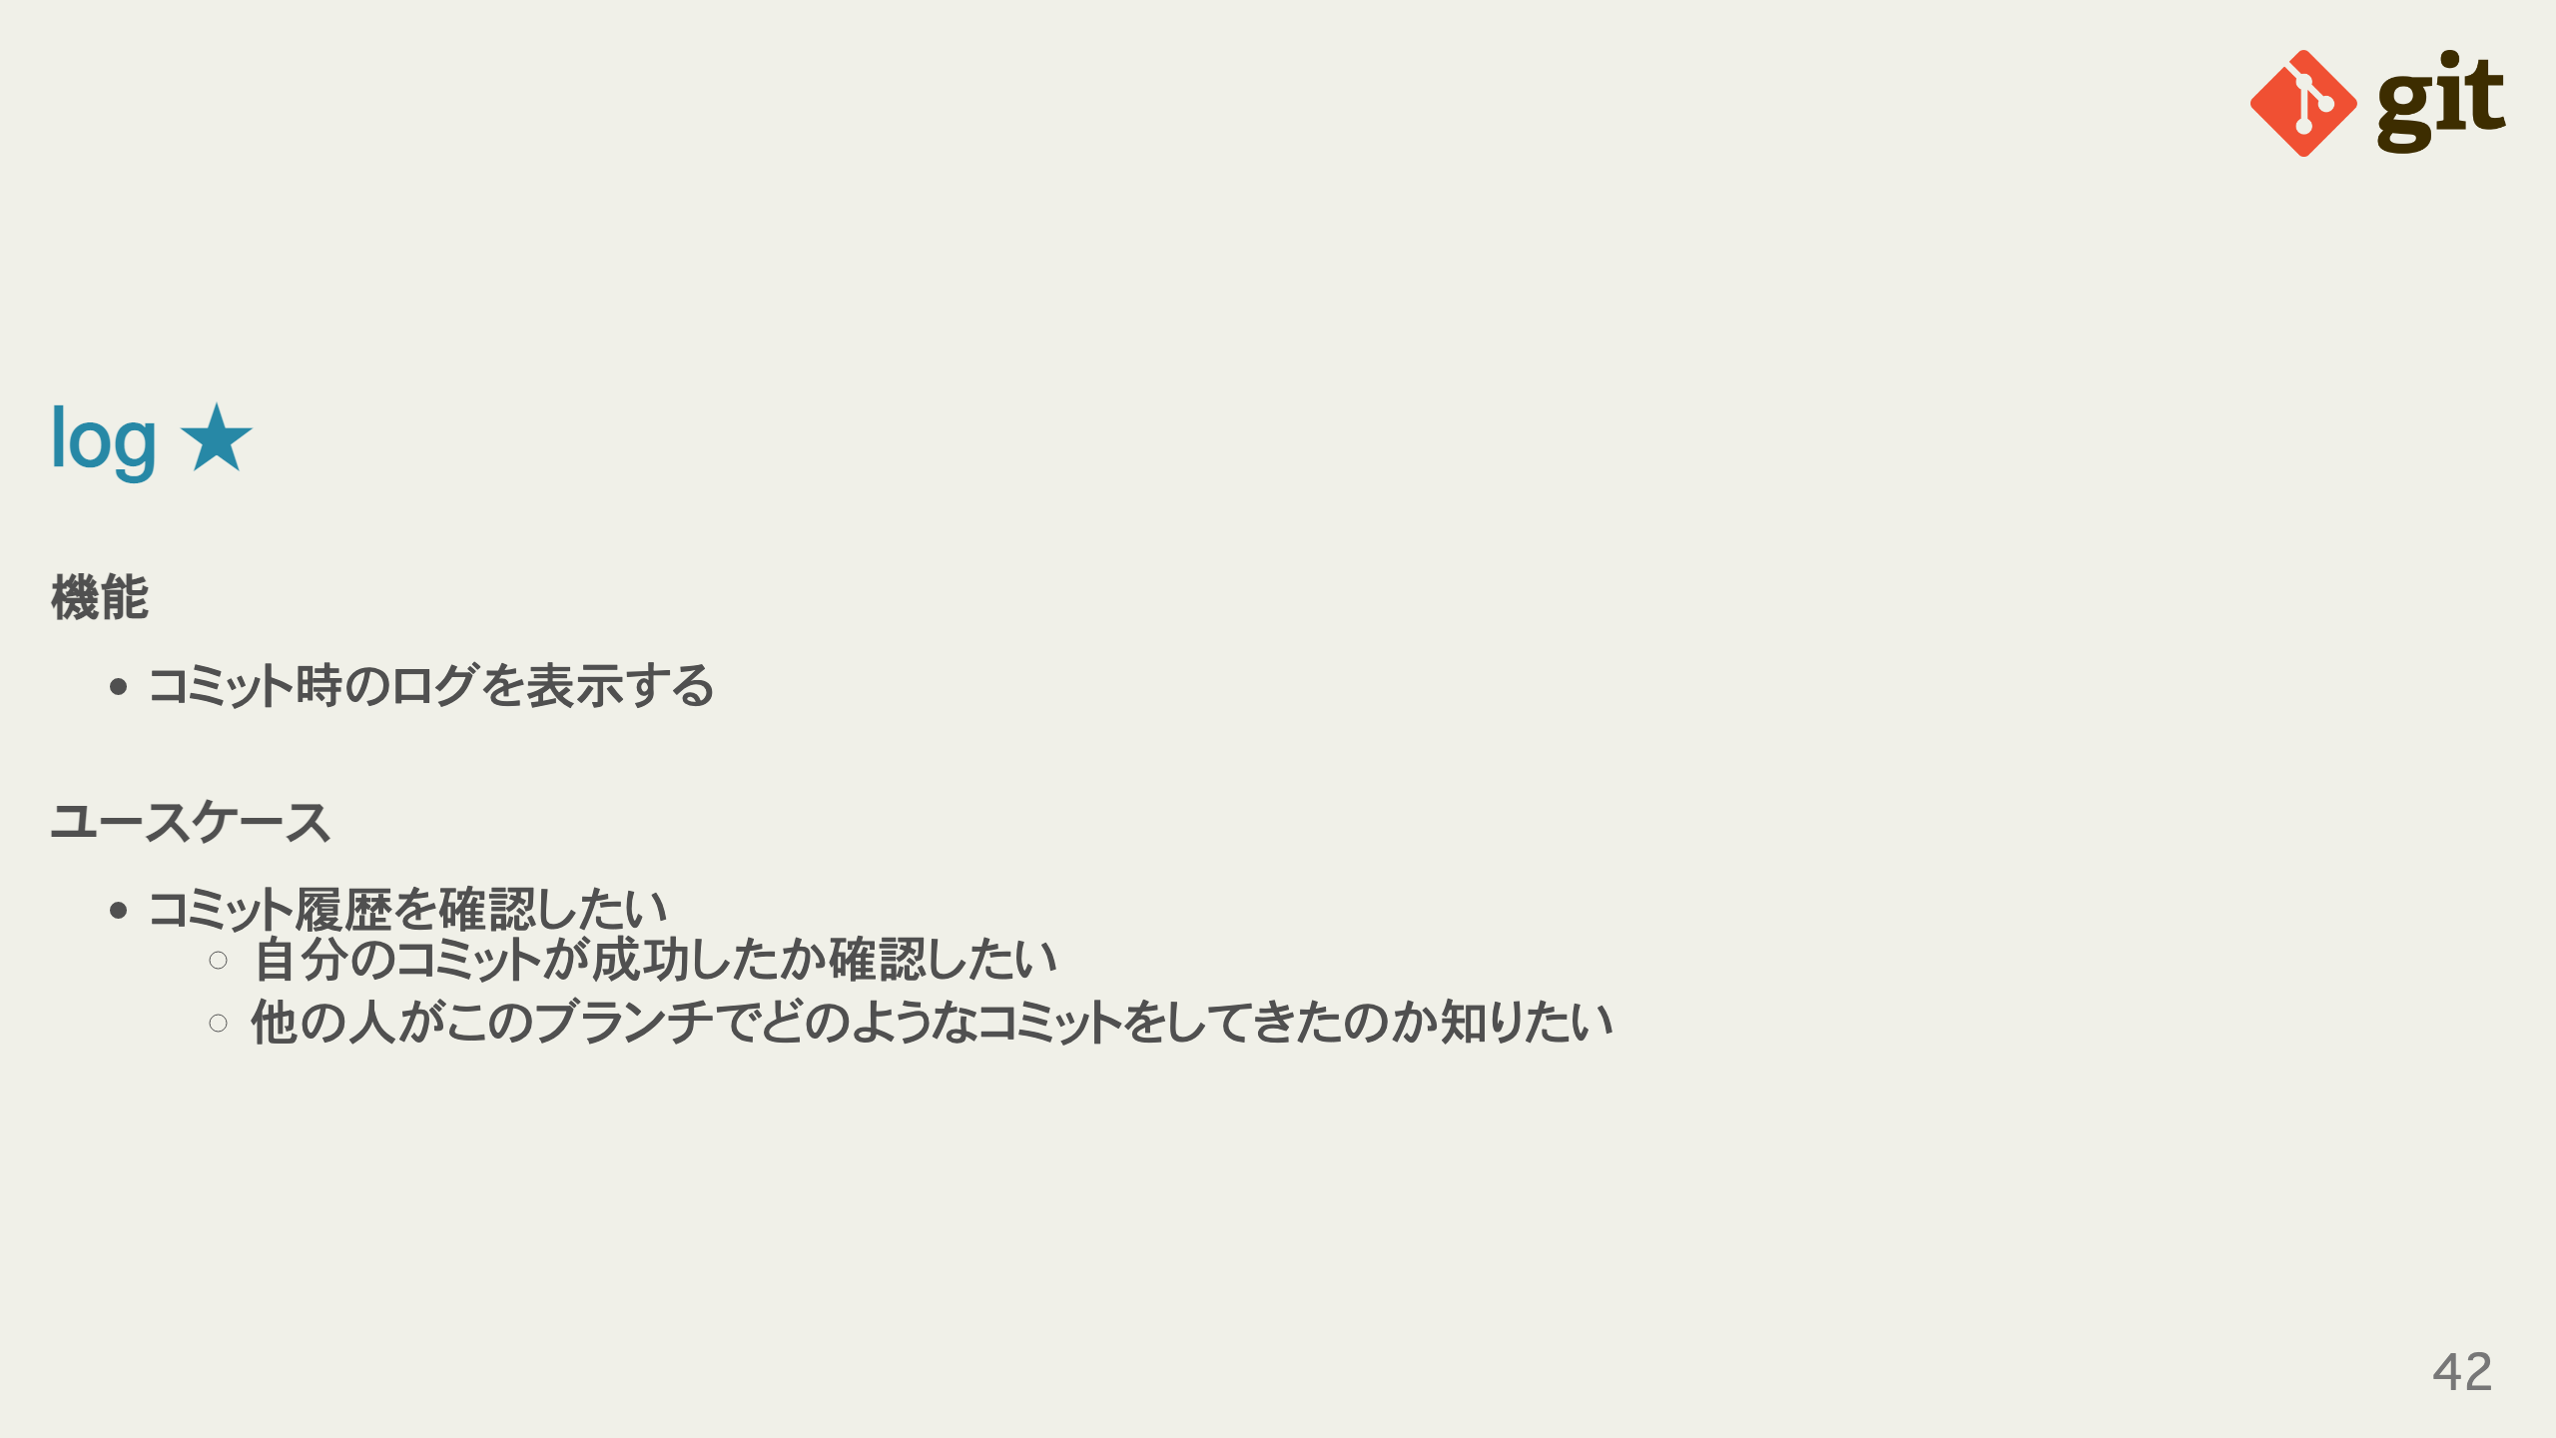
Notes:
omit in toc omit in toc

Slide 43
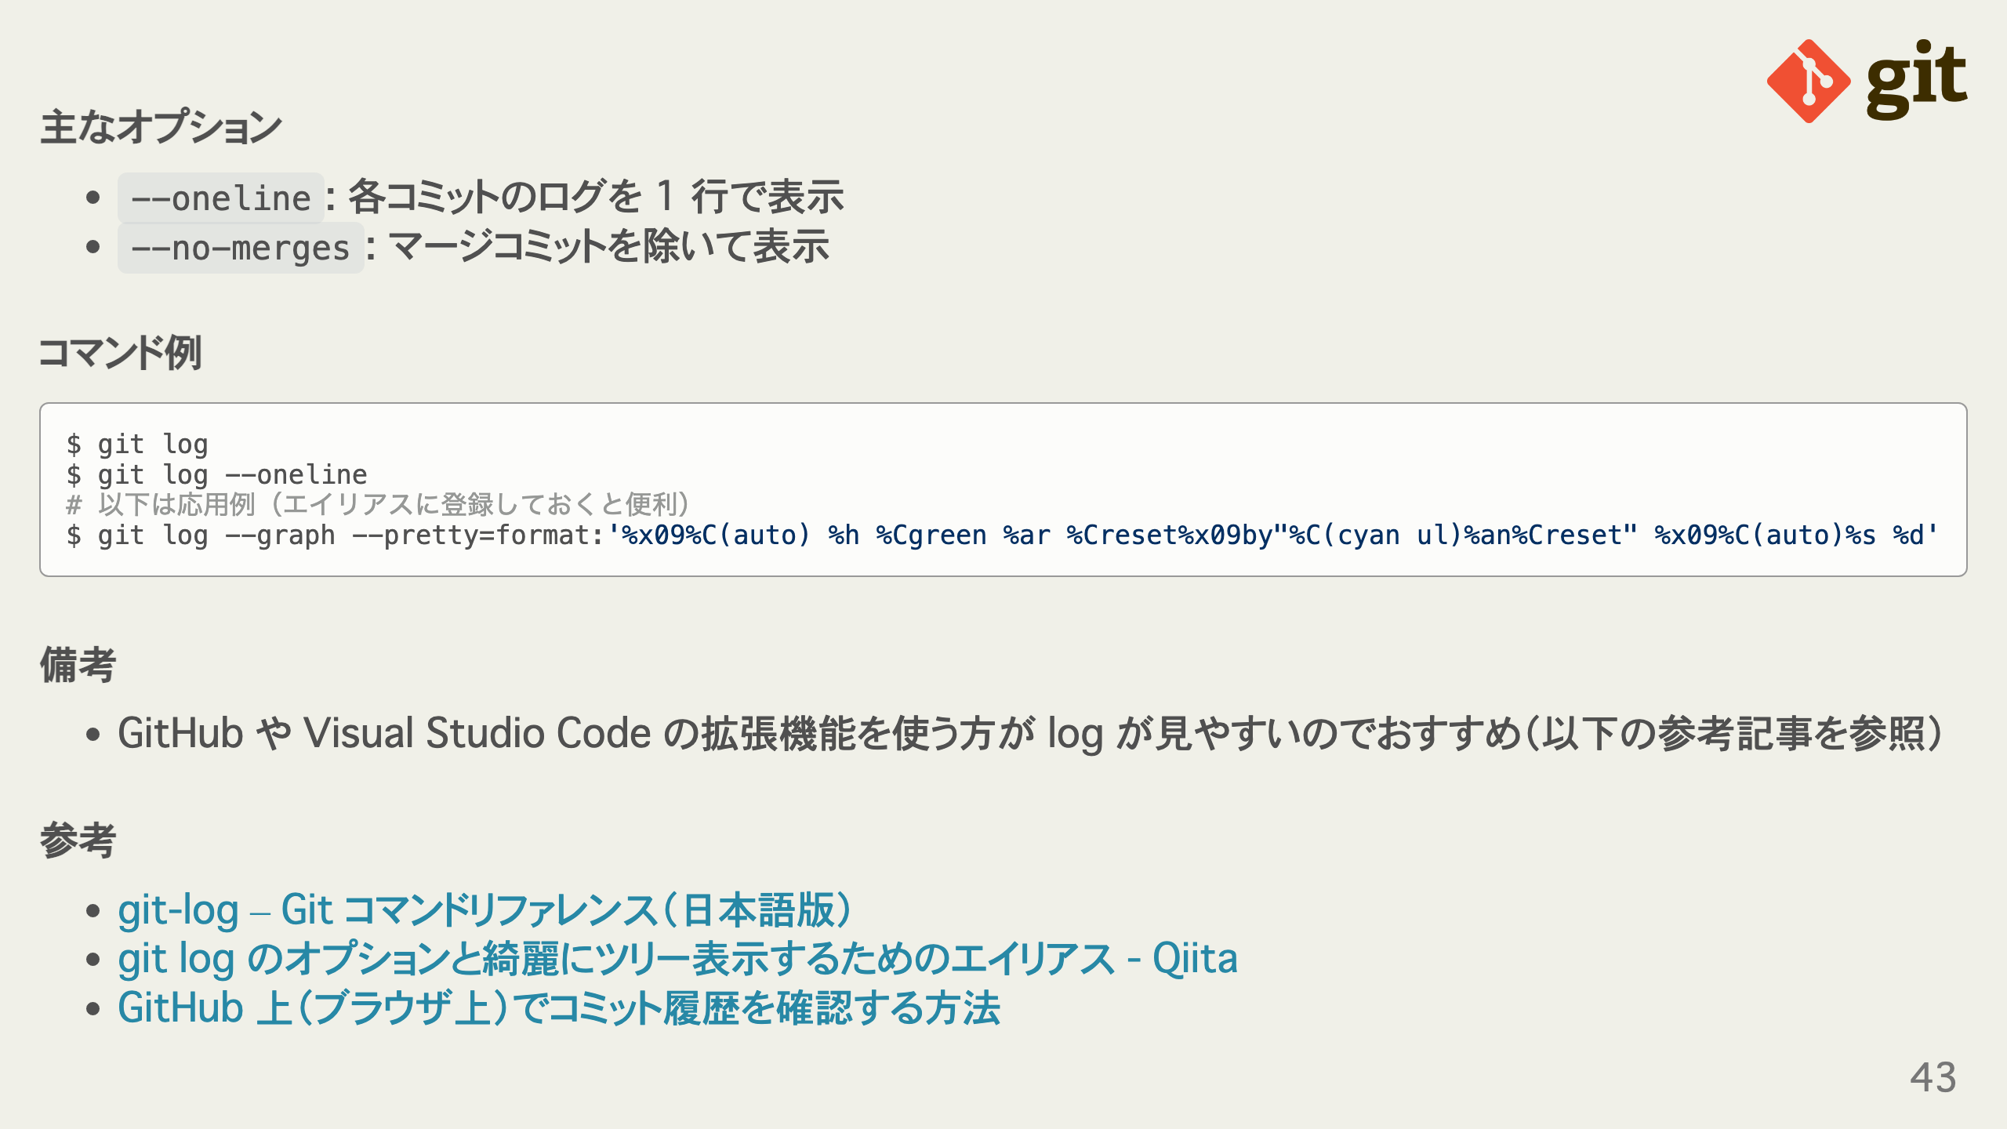
Notes:
omit in toc omit in toc omit in toc omit in toc

Slide 44
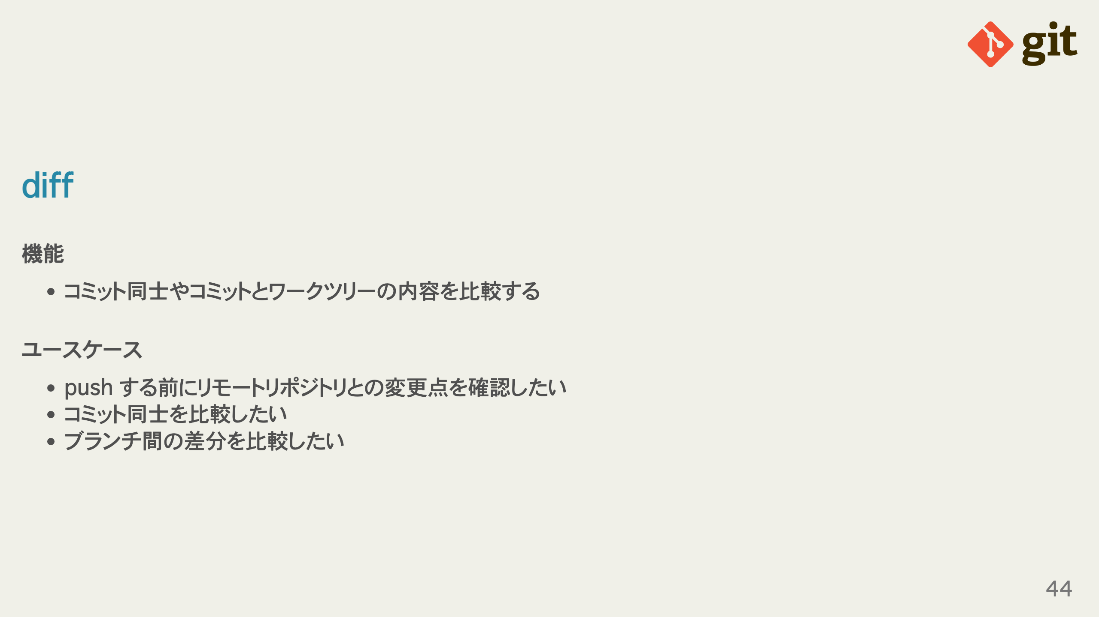
Notes:
omit in toc omit in toc

Slide 45
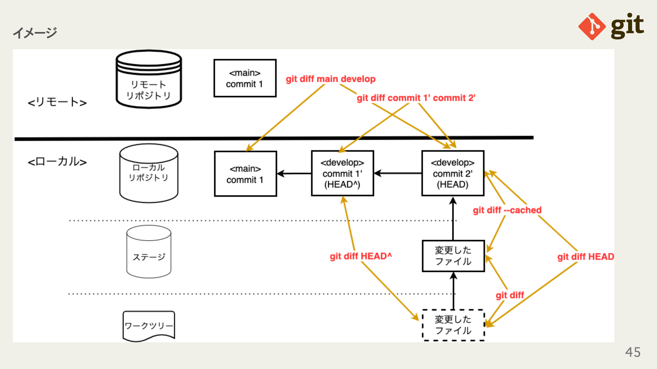
Notes:
omit in toc

Slide 46
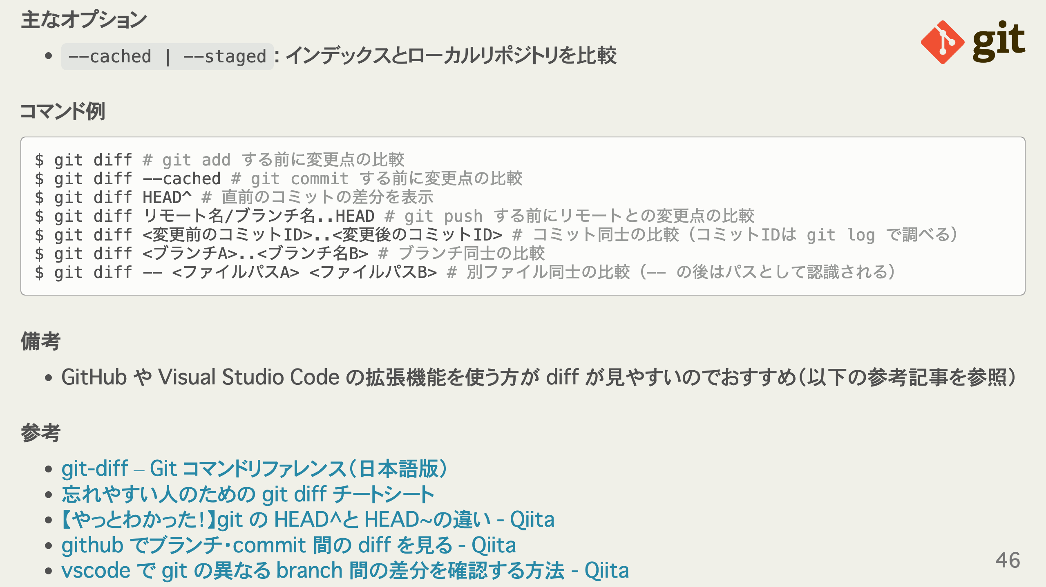
Notes:
omit in toc omit in toc omit in toc omit in toc

Slide 47
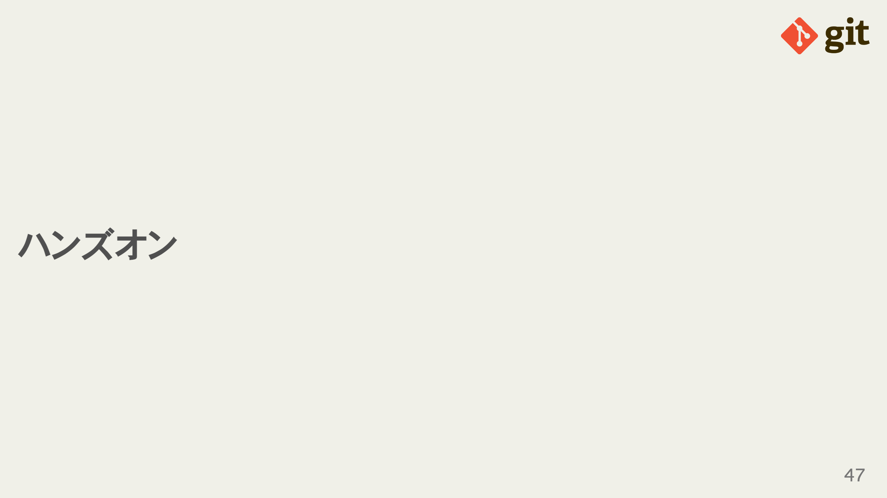

Slide 48
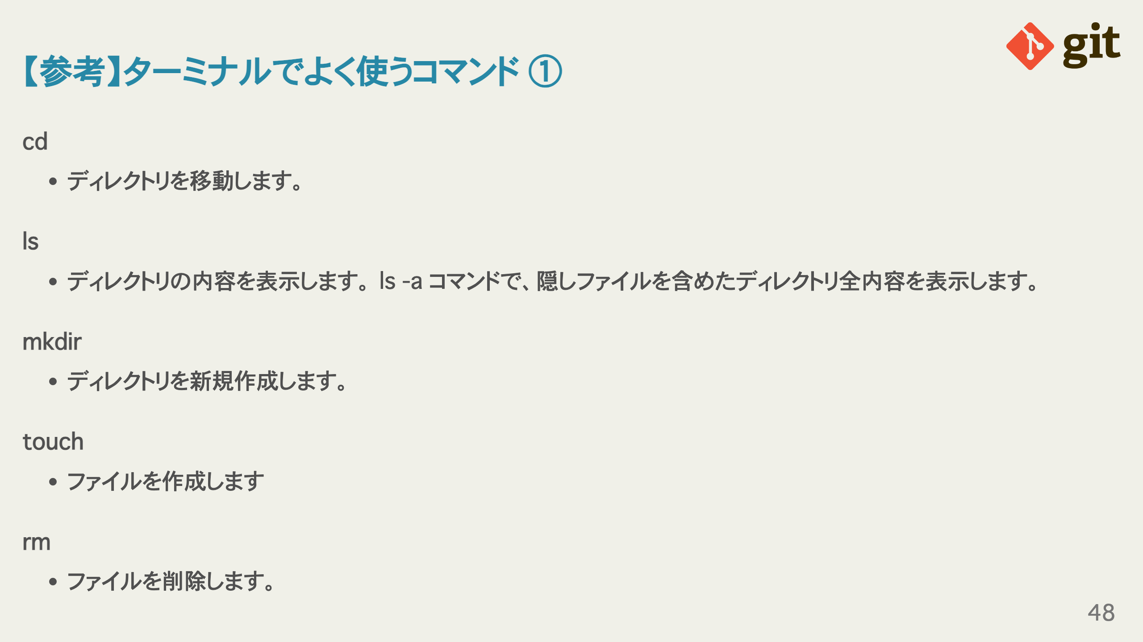
Notes:
omit in toc omit in toc omit in toc omit in toc omit in toc

Slide 49
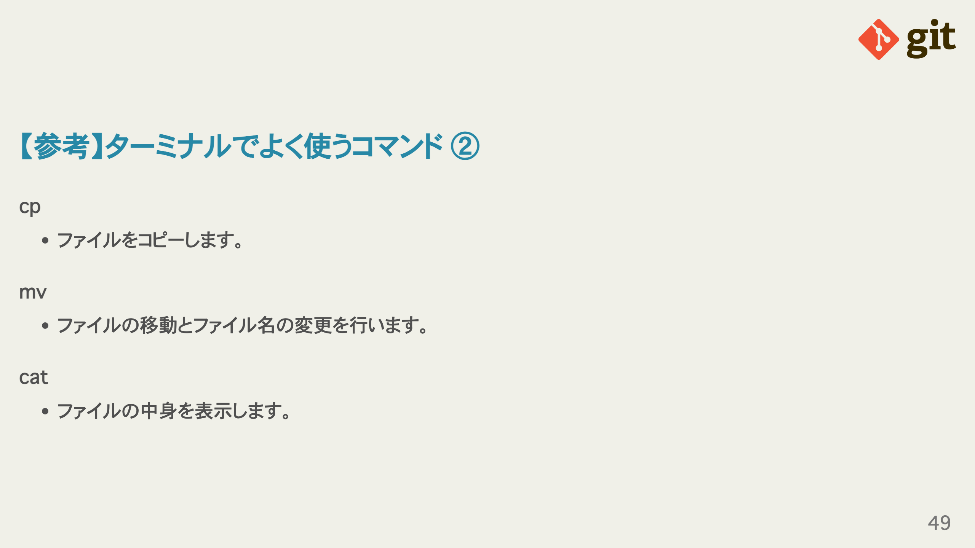
Notes:
omit in toc omit in toc omit in toc

Slide 50
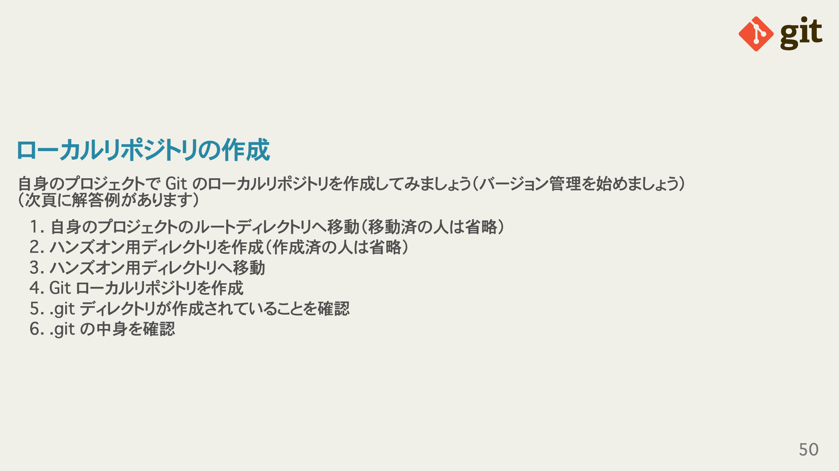

Slide 51

Notes:
omit in toc

Slide 52


Slide 53

Notes:
omit in toc

Slide 54


Slide 55

Notes:
omit in toc

Slide 56


Slide 57


Slide 58


Slide 59

Notes:
omit in toc omit in toc

Slide 60

Notes:
omit in toc

